Slide 1



Slide 2
Randox Company Overview
UK and Ireland’s largest diagnostic company
38 years of experience in healthcare diagnostics
Employing 1,400 people globally with 300 R&D scientists
International offices and distribution network in 145 countries
Products used by more than 100,000 laboratories worldwide
5% of world’s population diagnosed using Randox products
5th largest manufacturer of clinical chemistry reagents in the world
3rd party assay manufacturer for global IVD companies
3rd largest manufacturer of quality control and calibrators.
5%
World
Population

Slide 3



Our Capabilities
Primary Manufacturer of raw materials for use in Dx and Therapeutics
  Polyclonal and Monoclonal antibodies
  Antibody fragments (ScFv’s & sdAb’s)
  Recombinant proteins
IVD Assays and QC Material
  Development and manufacture of immunoassay and molecular assays
  Extensive test menu covering a wide range of disease states
  Capable of developing and commercializing assays on 3rd party analyzers
  Extensive portfolio of high-quality QC material
Biochip Array Technology
  Randox’s proprietary technology for multiplex testing across a wide portfolio of biomarkers with an expertise in inflammatory biomarkers.

Slide 4
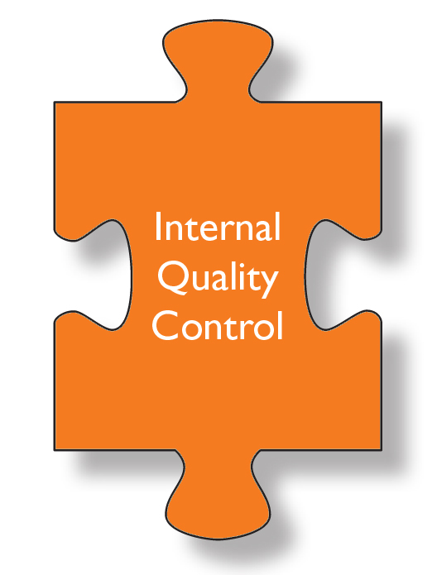





Randox Quality Control

Slide 5
Randox Acusera
Leading manufacturer of true third party control materials supplying over 60,000 laboratories worldwide
Flexible product range covering over 350 routine and esoteric analytes
World’s leading supplier of QC material to EQA schemes
3rd largest manufacturer of QC and calibrators globally
Choice of liquid or lyophilised controls depending on customer requirements
Largest manufacturer of customised quality controls

Slide 6
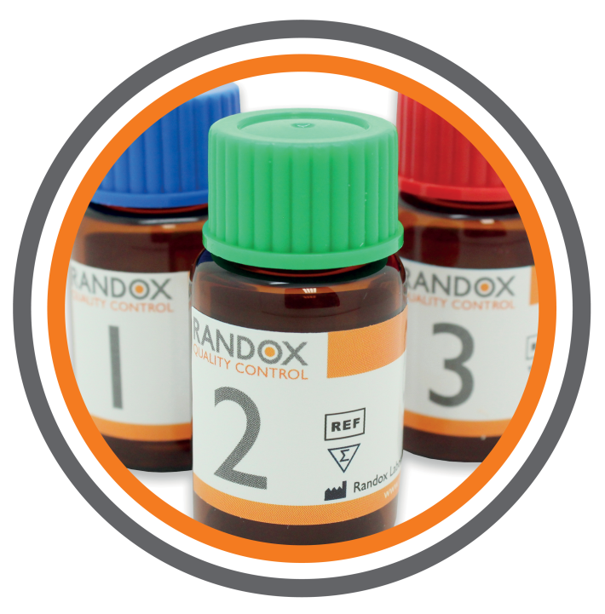
The Acusera QC Range
Clinical Chemistry
Immunoassay
Immunology/Proteins
Cardiac Markers
Haematology
Coagulation
Urine Chemistry
Drugs of Abuse
Therapeutic Drugs
Tumour Markers
Maternal Screening
Lipids
HbA1c
Blood Gas
Speciality/Research
Notes:
Highly innovative

Slide 7

Key Benefits
  Cost Effective
    Consolidation
    Clinically significant levels
    Reduced waste
  High Quality
    Accurate
    True third party
    Commutable
    Consistent
    Material and Manufacturing
  Flexibility
    Extensive analyte menu
    Variety of formats
Cost Effective + High Quality + Flexibility = Increased Efficiency and Accuracy

Slide 8
Biochemistry Reagents
The market-leading reagents portfolio from Randox is internationally recognised as being of the highest quality, offering rapid and reliable results.
Choice
Over 100 assays for biochemical use
Over 450 reagent kits to choose from, incorporating different reagent formats, method options and kit sizes
Quality
Outstanding assay development in combination with high performance methodologies contribute to the uncompromised quality offered by Randox reagents
Innovation
Randox can provide an extensive range of speciality assays which offer laboratories the opportunity to benefit from more advanced testing

Slide 9
Test Menu
The test menu offered by Randox includes the most extensive range of 115 routine and niche tests:
Acetaminophen
Acid Phos.
Adiponectin
Albumin
Aldolase
ALP
α-I-Acid Glycoprotein
α-I-Antitrypsin
ALT
Ammonia
Amylase
Amylase (Pancreatic)
ASO
Apo A-I
Apo A-II
Apo B
Apo C-II
Apo C-III
Apo E
AST
Barbiturates
Benzodiazepines
ß₂M
Bile Acids
Bilirubin (Total/Direct)
Calcium
Cannabinoids
Carbamazepine
Ceruloplasmin
Chloride
Cholesterol (Total)
HDL
HDL2/3
LDL
sdLDL-C
Cholinesterase
CK-MB
CK-NAC
CO₂ Total
Cocaine Metabolite
C-C3
C-C4
Copper
Creatinine
CRP
Canine CRP
frCRP
hsCRP
Cystatin C
Digoxin
Ecstasy
EDDP
Ethanol
Fibrinogen
Ferritin
Fructosamine
G-6-PDH
GGT
Gentamicin
GLDH
Glucose
Glutamate
Glutamine
Glutathione Peroxidase
Glutathione Reductase
Glycerol
Haemoglobin
Haptoglobin
HbA1c
H-FABP
Homocysteine
D-3-H
IgA
IgE
IgG
IgM
Iron
Iron/UIBC
Lactate
LDH
LAP
Lipase
Lp(a)
Lithium
Magnesium
Methadone
Methamp.
Microalbumin
Myoglobin
NEFA
Opiates
Phenobarbital
Phenytoin
Phosphorus
Potassium
Pregnancy Test
RF
Sodium
Soluble Transferrin Receptor (sTfR)
sPLA₂-IIA
Superoxide Dismutase
Syphilis
TIBC
TAS
Total Protein
Transferrin
Transthyretin (Prealbumin)
Triglycerides
TxBCardio
Urea
Uric Acid
Urinary Protein
Valproic Acid
Zinc

Slide 10
Analyser Applications
The analyser applications service at Randox is unparalleled with over 13,000 applications on record!
We have applications for the following analysers:
Abbott Aeroset/Architect C
Beckman Synchron CX4/5/7/9/LX20/DXC
Biolis 24I/Prestige 24I
Cobas 4000/6000/8000
Cobas Integra 400/800
Hitachi 717/911/912
Hitachi 917/Modular P
Mindray BS Series
Ortho Vitros 5600/ Ortho Vitros 5/ Ortho I FS/ Ortho 4600
Olympus (Beckman Coulter) AU400/600/640/2700/5400
Pentra 400
Siemens Dimension RXL/Xpand
Thermo Konelab 20i/30i/60i
Vitalab Flexor/Selectra E/Selectra II
…plus many more!

Slide 11
Randox – Outstanding reagents manufacturing
Randox is continuously investing in our manufacturing capacity and ways to improve the quality and efficiency of our operations.
Within our manufacturing process Randox have extremely tight manufacturing tolerances which ensures uniformity across reagent batches.
Randox reagents therefore offer minimal lot-to-lot variation and consistent high quality performance, giving laboratories confidence in the results they produce.
Randox reagents also display excellent correlation to reference methods
Randox assays are validated against gold-standard methodologies to ensure performance is of the highest degree and that results returned are as accurate as possible

Slide 12
Niche Tests from Randox

Slide 13
Randox Lipoprotein(a)
Proven performance for truly accurate results
The Randox Lp(a) assay is one of the only methodologies on the market that detects the non-variable part of the Lp(a) molecule and therefore suffers minimal size related bias - providing more accurate and consistent results. The Randox Lp(a) kit is standardised to the WHO/ IFCC reference material SRM 2B and is closest in terms of agreement to the ELISA reference method.
Five calibrators with accuracy-based assigned target values are provided - which accurately reflect the heterogeneity of isoforms present in the general population
Measuring units available in nmol/L upon request
Highly sensitive and specific - method for Lp(a) detection in serum and plasma
Applications are available for a wide range of biochemistry analysers - which detail instrument-specific settings for the convenient use of Randox Lp(a) on a variety of systems
Liquid ready-to-use reagents - for convenience and ease-of-use
Lp(a) controls and calibrator available

Slide 14
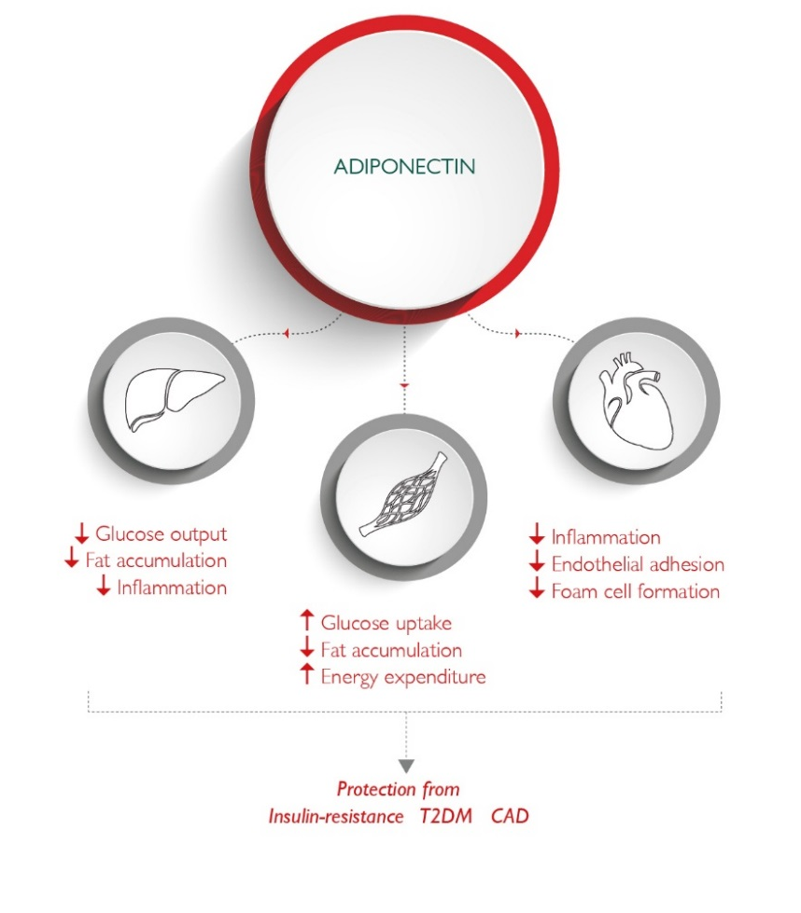
Randox Adiponectin
A niche product from Randox meaning that we are one of the only manufacturers to provide the adiponectin test in an automated biochemistry format
Automated immunoturbidimetric assay - offering a more convenient and time efficient method for adiponectin measurement than traditional ELISA based testing
Liquid ready-to-use reagents - for convenience and ease of use
28 day on-board stability at approximately +10ºC – minimising reagent waste
Applications available - with instrument specific settings for a wide range of analysers
Adiponectin controls and adiponectin calibrator available

Slide 15
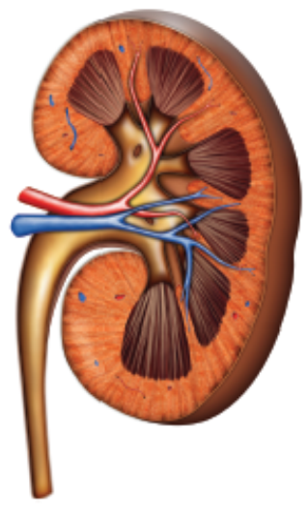
Randox Cystatin C
Liquid ready-to-use reagents - for ease of use and convenience
Extensive measuring range - 0.4-10 mg/l. The approximate normal range for cystatin C is 0.57-1.05 mg/l therefore the Randox Cystatin C assay will comfortably detect abnormal concentrations
Excellent on board stability - 28 days at +10°C minimising reagent waste
Latex Enhanced Immunoturbidimetric method
Cystatin C control and cystatin C calibrator available

Slide 16
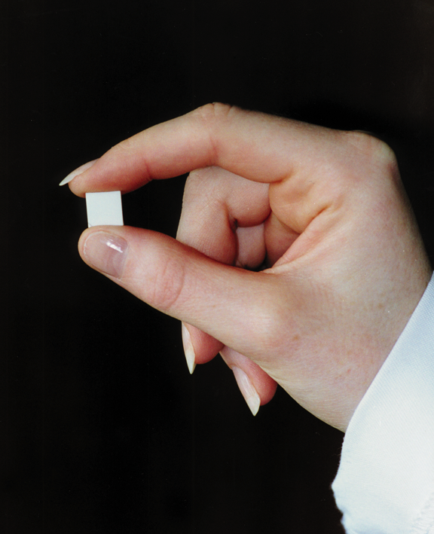
Biochip Array Technology
The Biochip
A chemically activated 9x9mm ceramic chip
Able to multiplex up to 25 discrete test regions for immunoassay and 100 for molecular assays (includes 3 internal control/reference spots)
Enables multiple assays to be performed simultaneously (immunoassay or molecular)
Utilises ELISA assay methodologies (sandwich or competitive)
Offers more flexible batch sizes than traditional ELISA plate testing
Utilizes a smaller sample volume – 100ul per panel

Slide 17
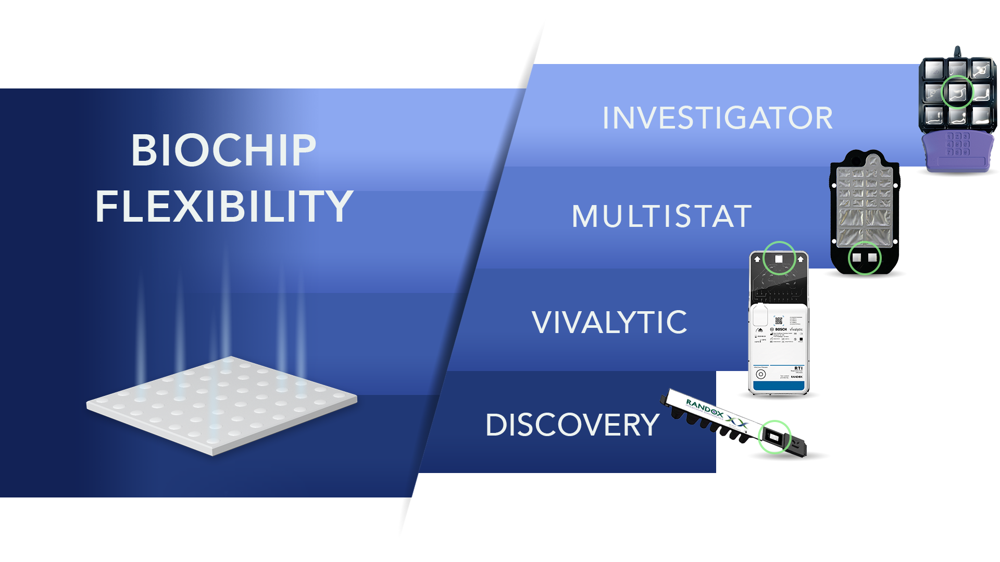
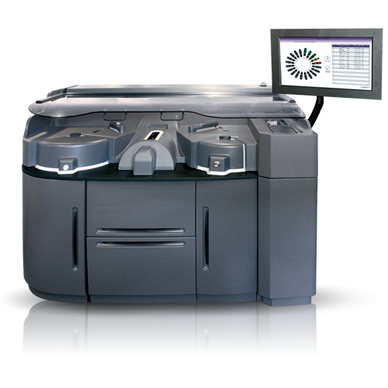
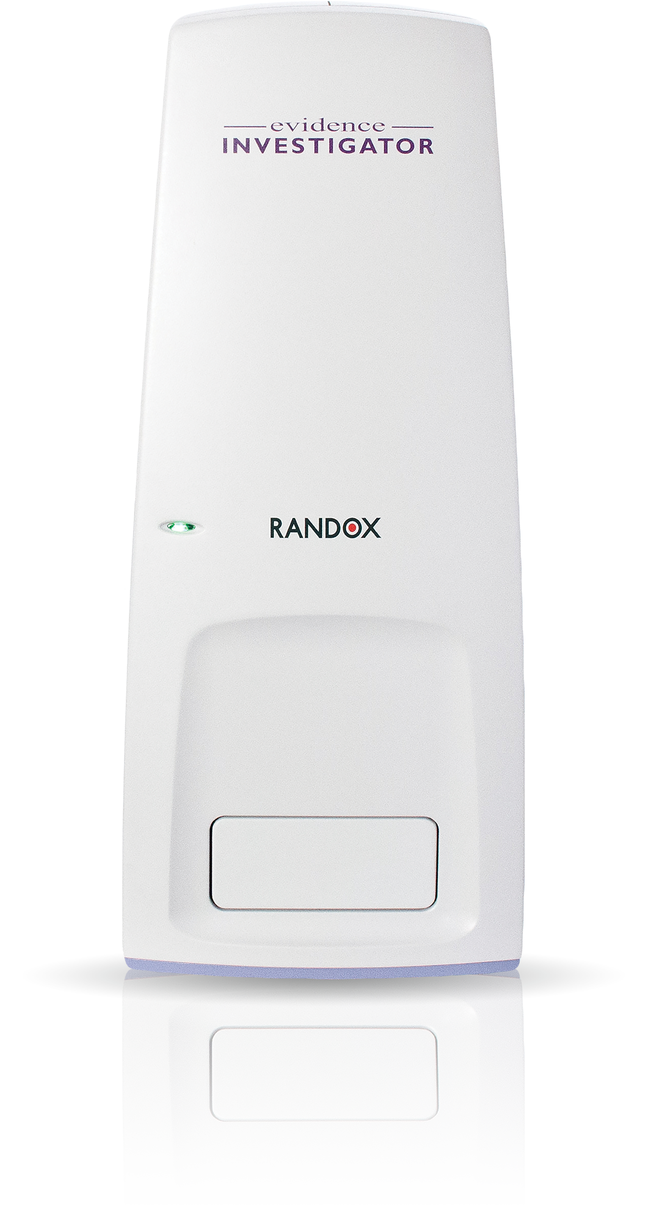
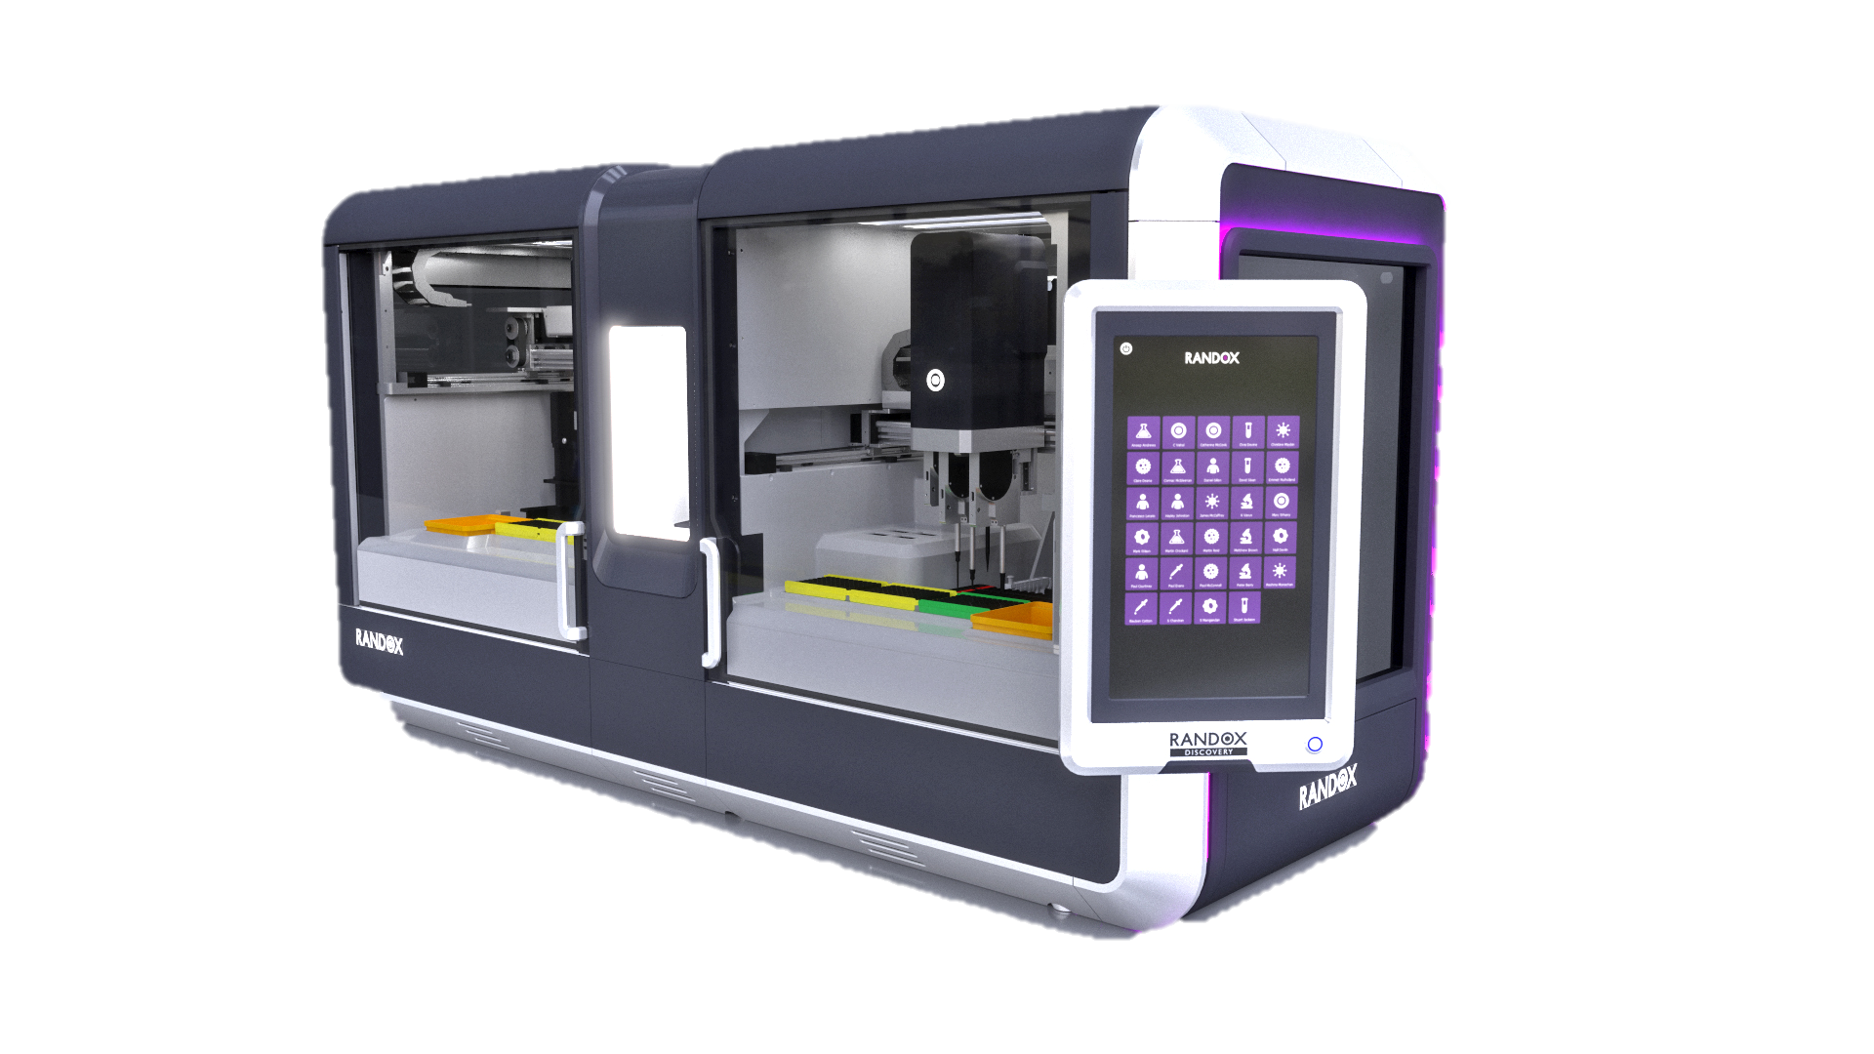
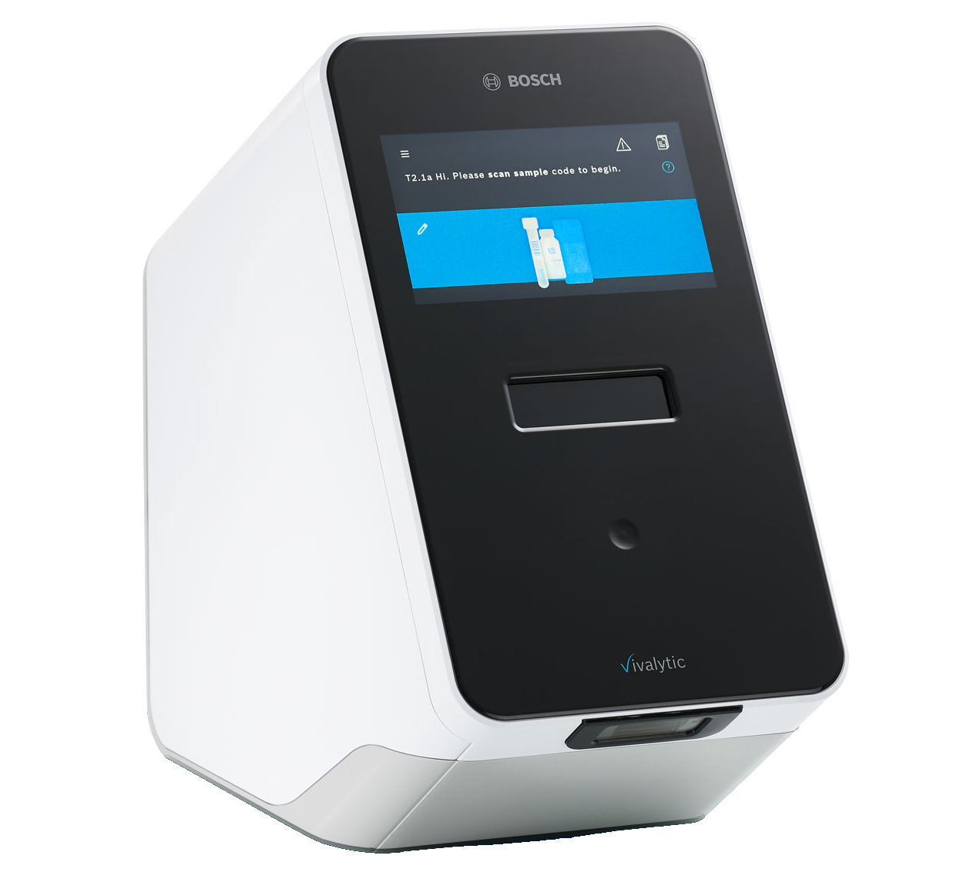
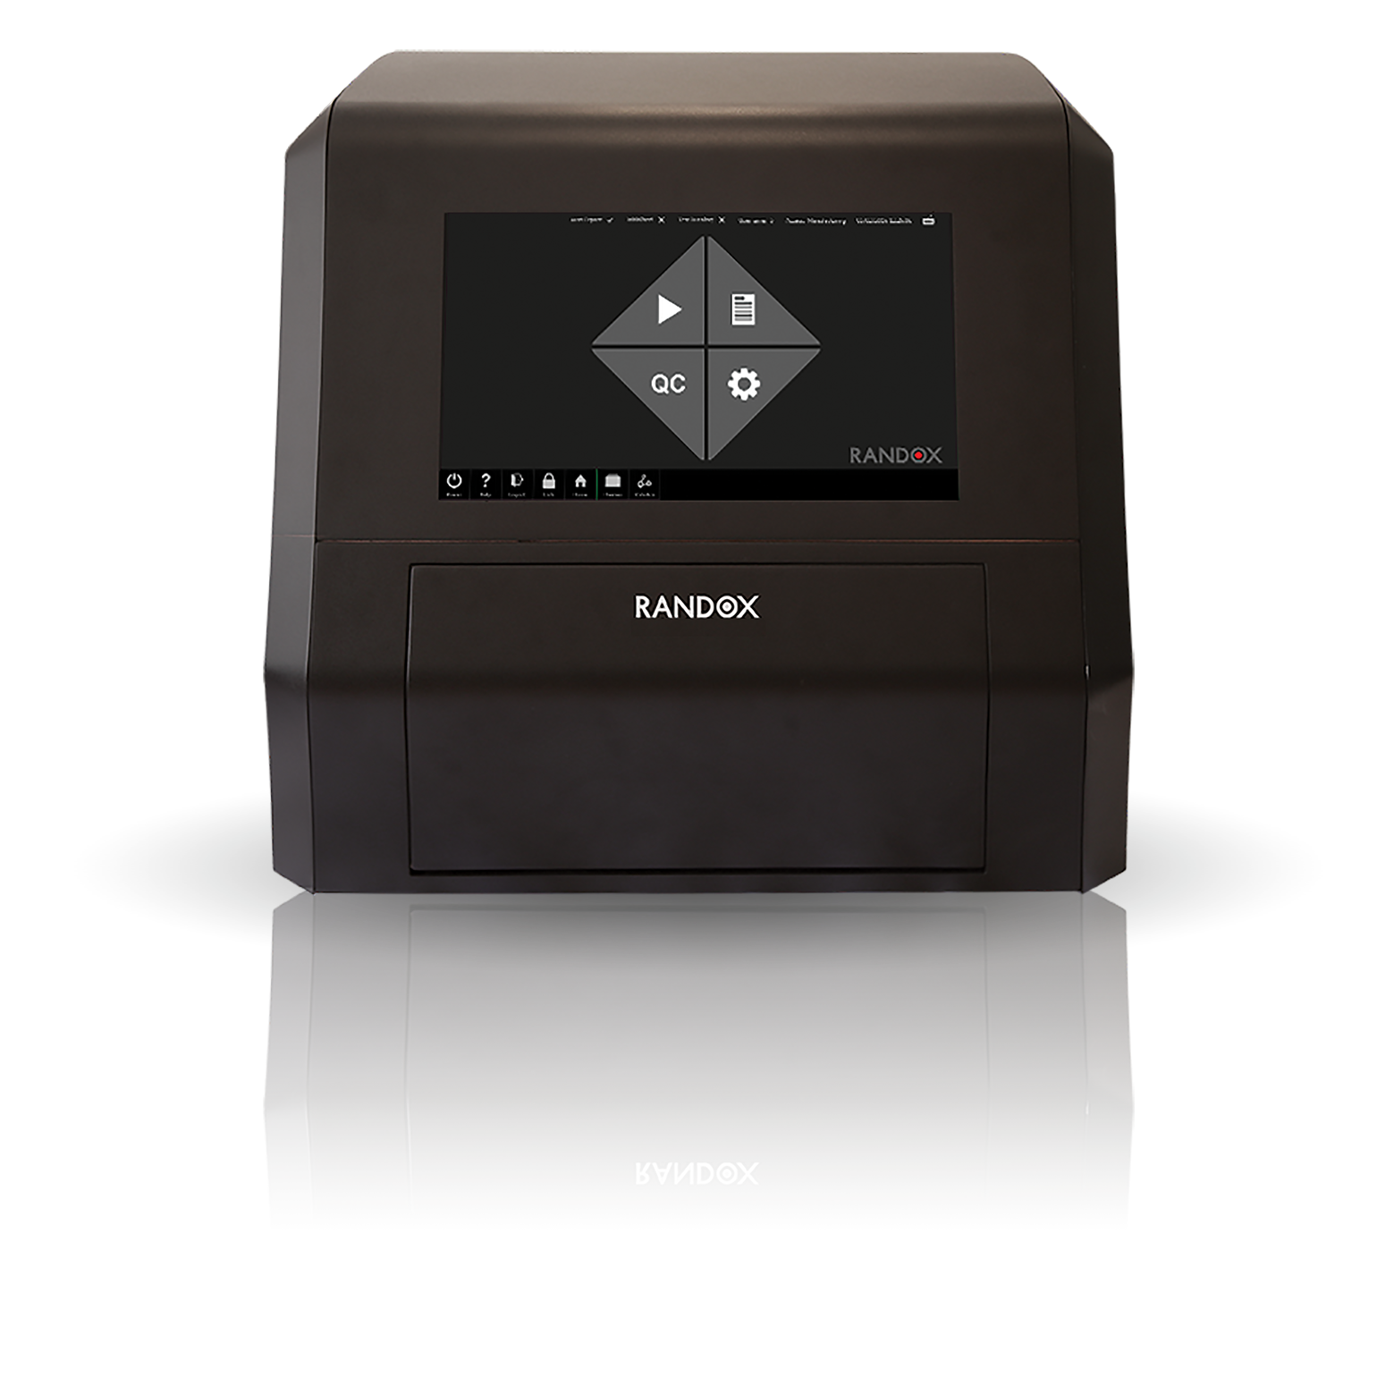
Biochip Versatility
Vivalytic
MultiSTAT
Investigator
Discovery
Evolution
POC Semi-Automated Fully Automated

Slide 18
Custom Assay Development
Pharma customers advise their selected biomarkers (based on their clinical discovery work) which have been identified for further exploration in their clinical studies.
Randox has an extensive library of biomarkers which can be custom integrated to meet assay requirement.
  If a new panel is required, and recommend how best to design the assay to meet your needs.
Randox has in-house design team, if a new panel is required. The team will recommend how best to design the assay/panel to meet pharma needs.
Randox will complete feasibility incorporating assay optimization and development to an initial RUO stage.
In-house custom development and manufacturing, under full design control, supported by highly experienced QA team.
Submission of array requirements
Custom Team carry out feasibility & provide a quotation
Manufacture to customer specifications
Assays used for sample analysis
Notes:
Why do we need new safety biomarkers? It turns out that more than 50% of drugs in development due not make it due to safety.
In fact, of those that slip through the cracks, 2-3% are removed from the market due to unexpected toxicity.
Regardless, there is still a lack of implementation of safety biomarkers during clinical trials. The FDA recognizes this lack of safety as part of the “Pipeline Problem”.
There is a need to assess organ injury early on in a clinical trial to ensure a drug is safe and can avoid late-stage (Phase II or III) failures.
The PSTC , or Predictive Safety Testing Consortium was established to improve safety testing by evaluating and characterizing biomarkers for FDA Qualification.
The PSTC started with kidney injury biomarkers. Currently, creatinine and BUN are the gold standards but are insensitive. Delayed assessment could lead to irreversible kidney damage.
AKI can be identified using more sensitive biomarkers.

Slide 19

Biomarker examples

Slide 20
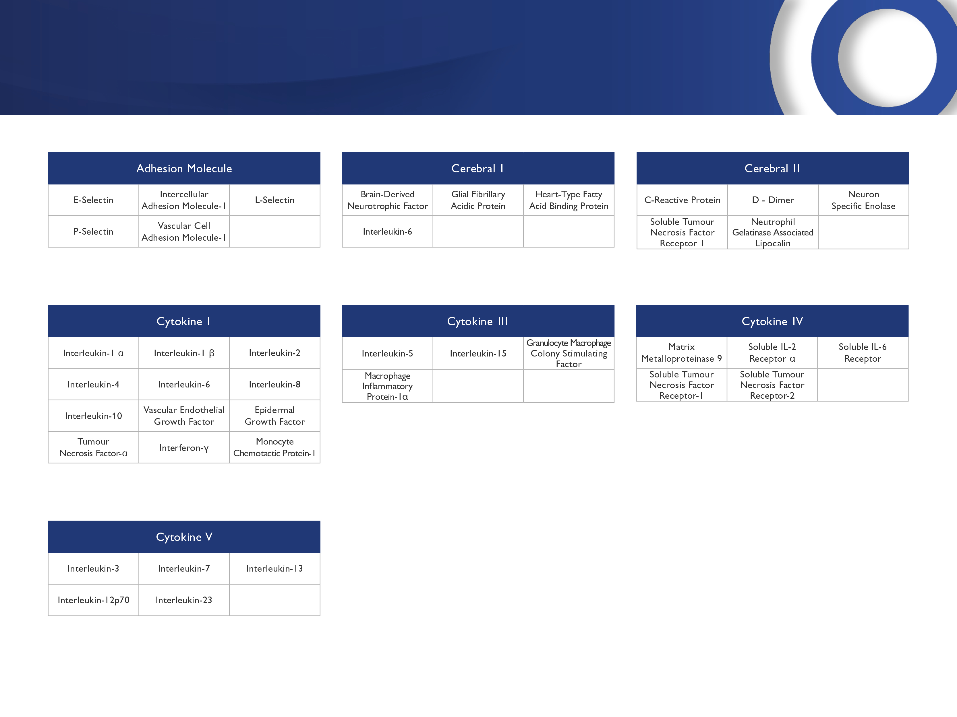
RANDOX

Slide 21
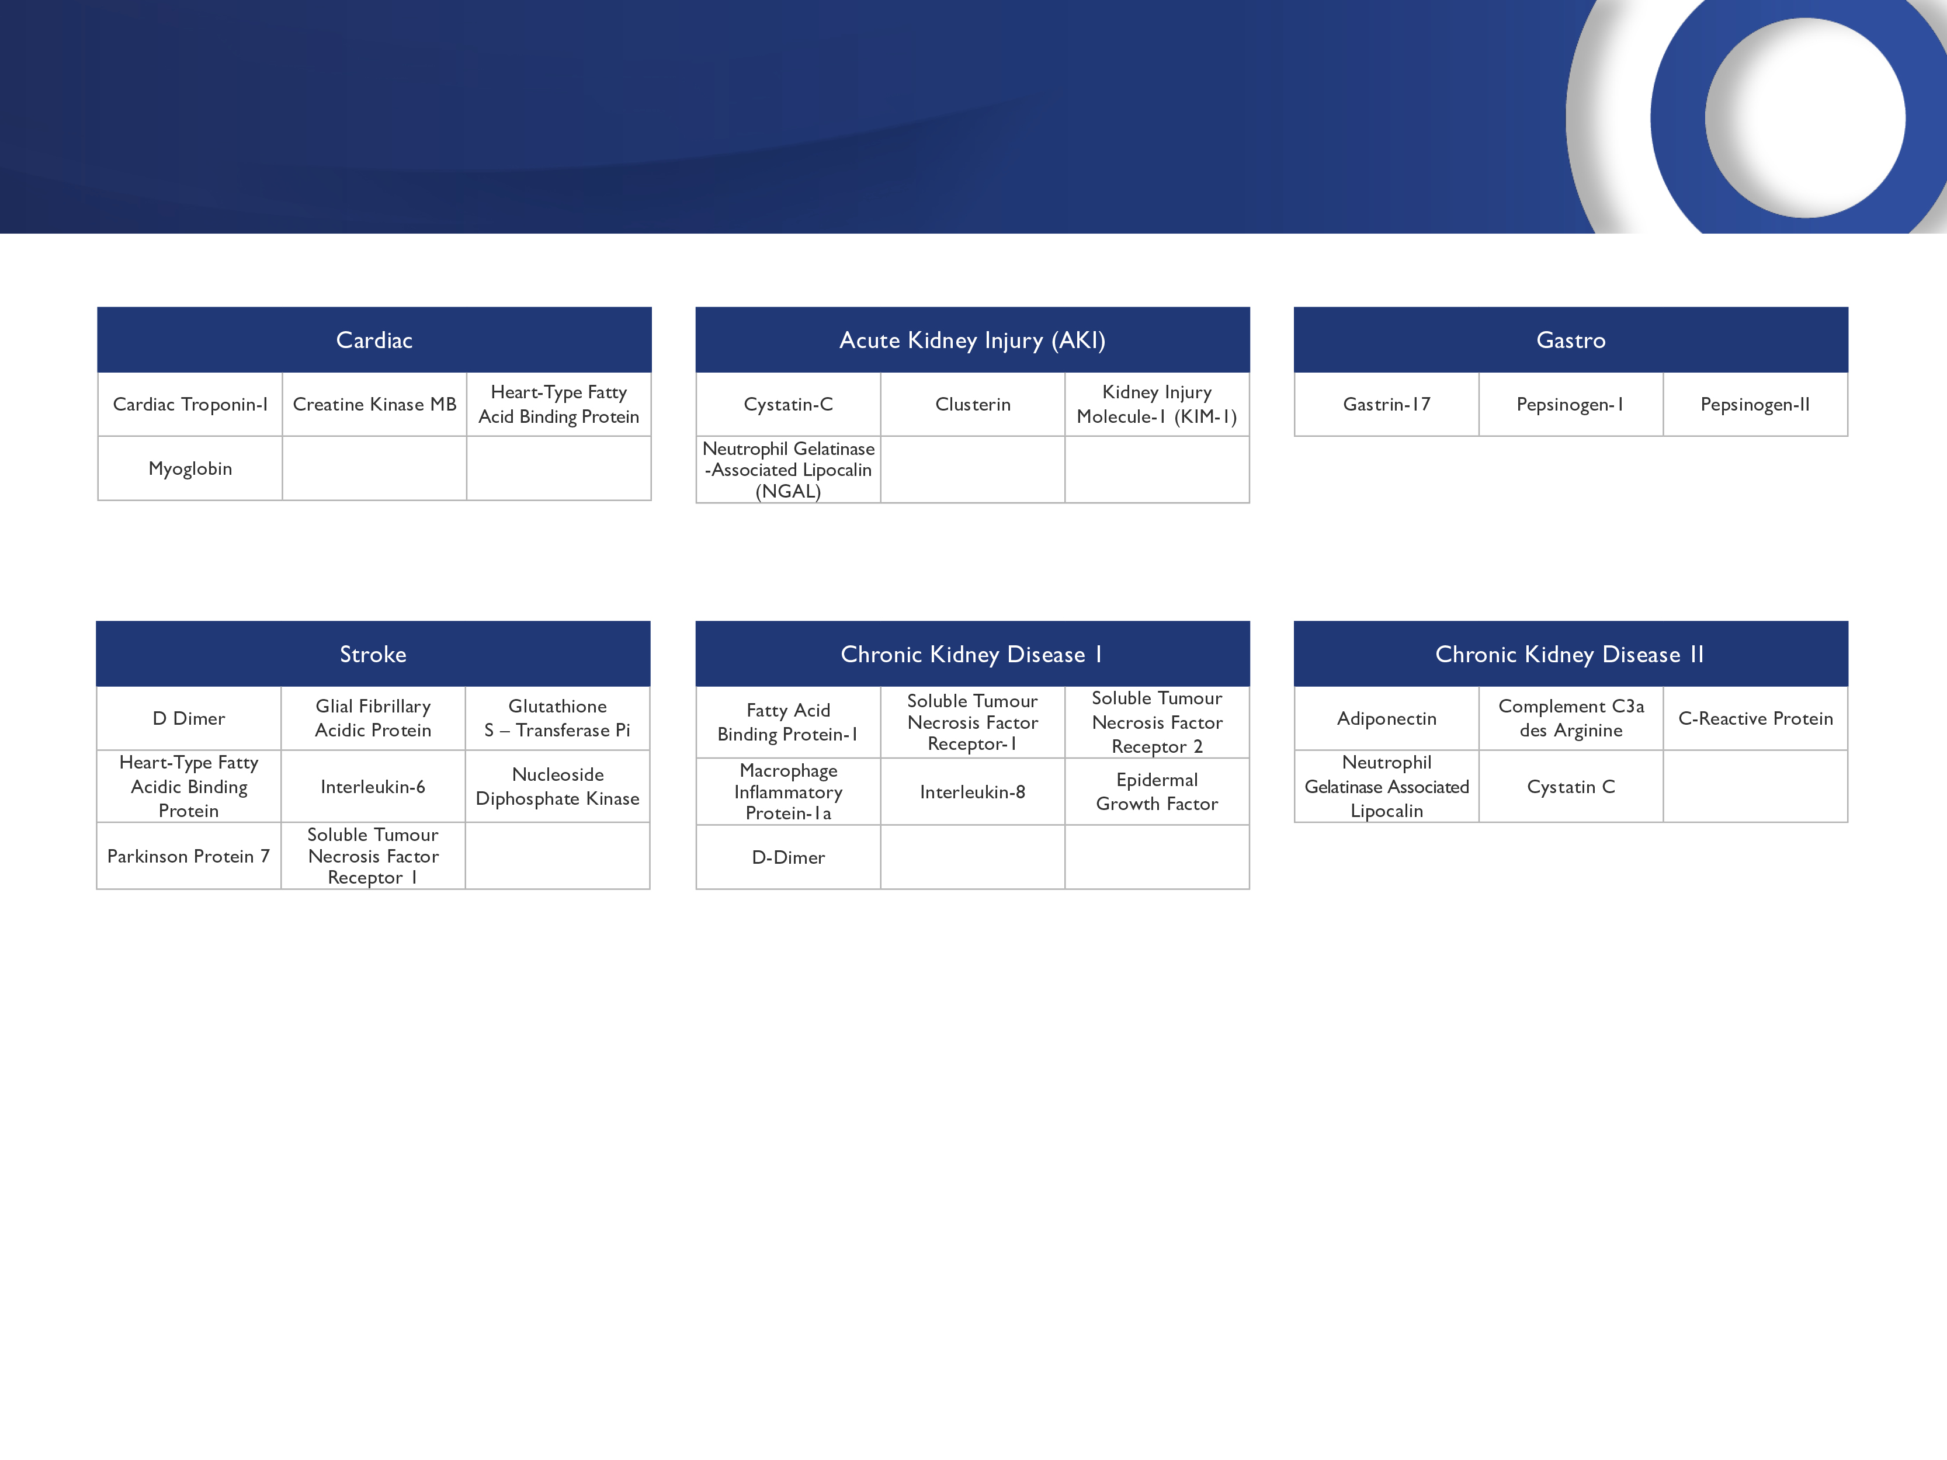
RANDOX

Slide 22
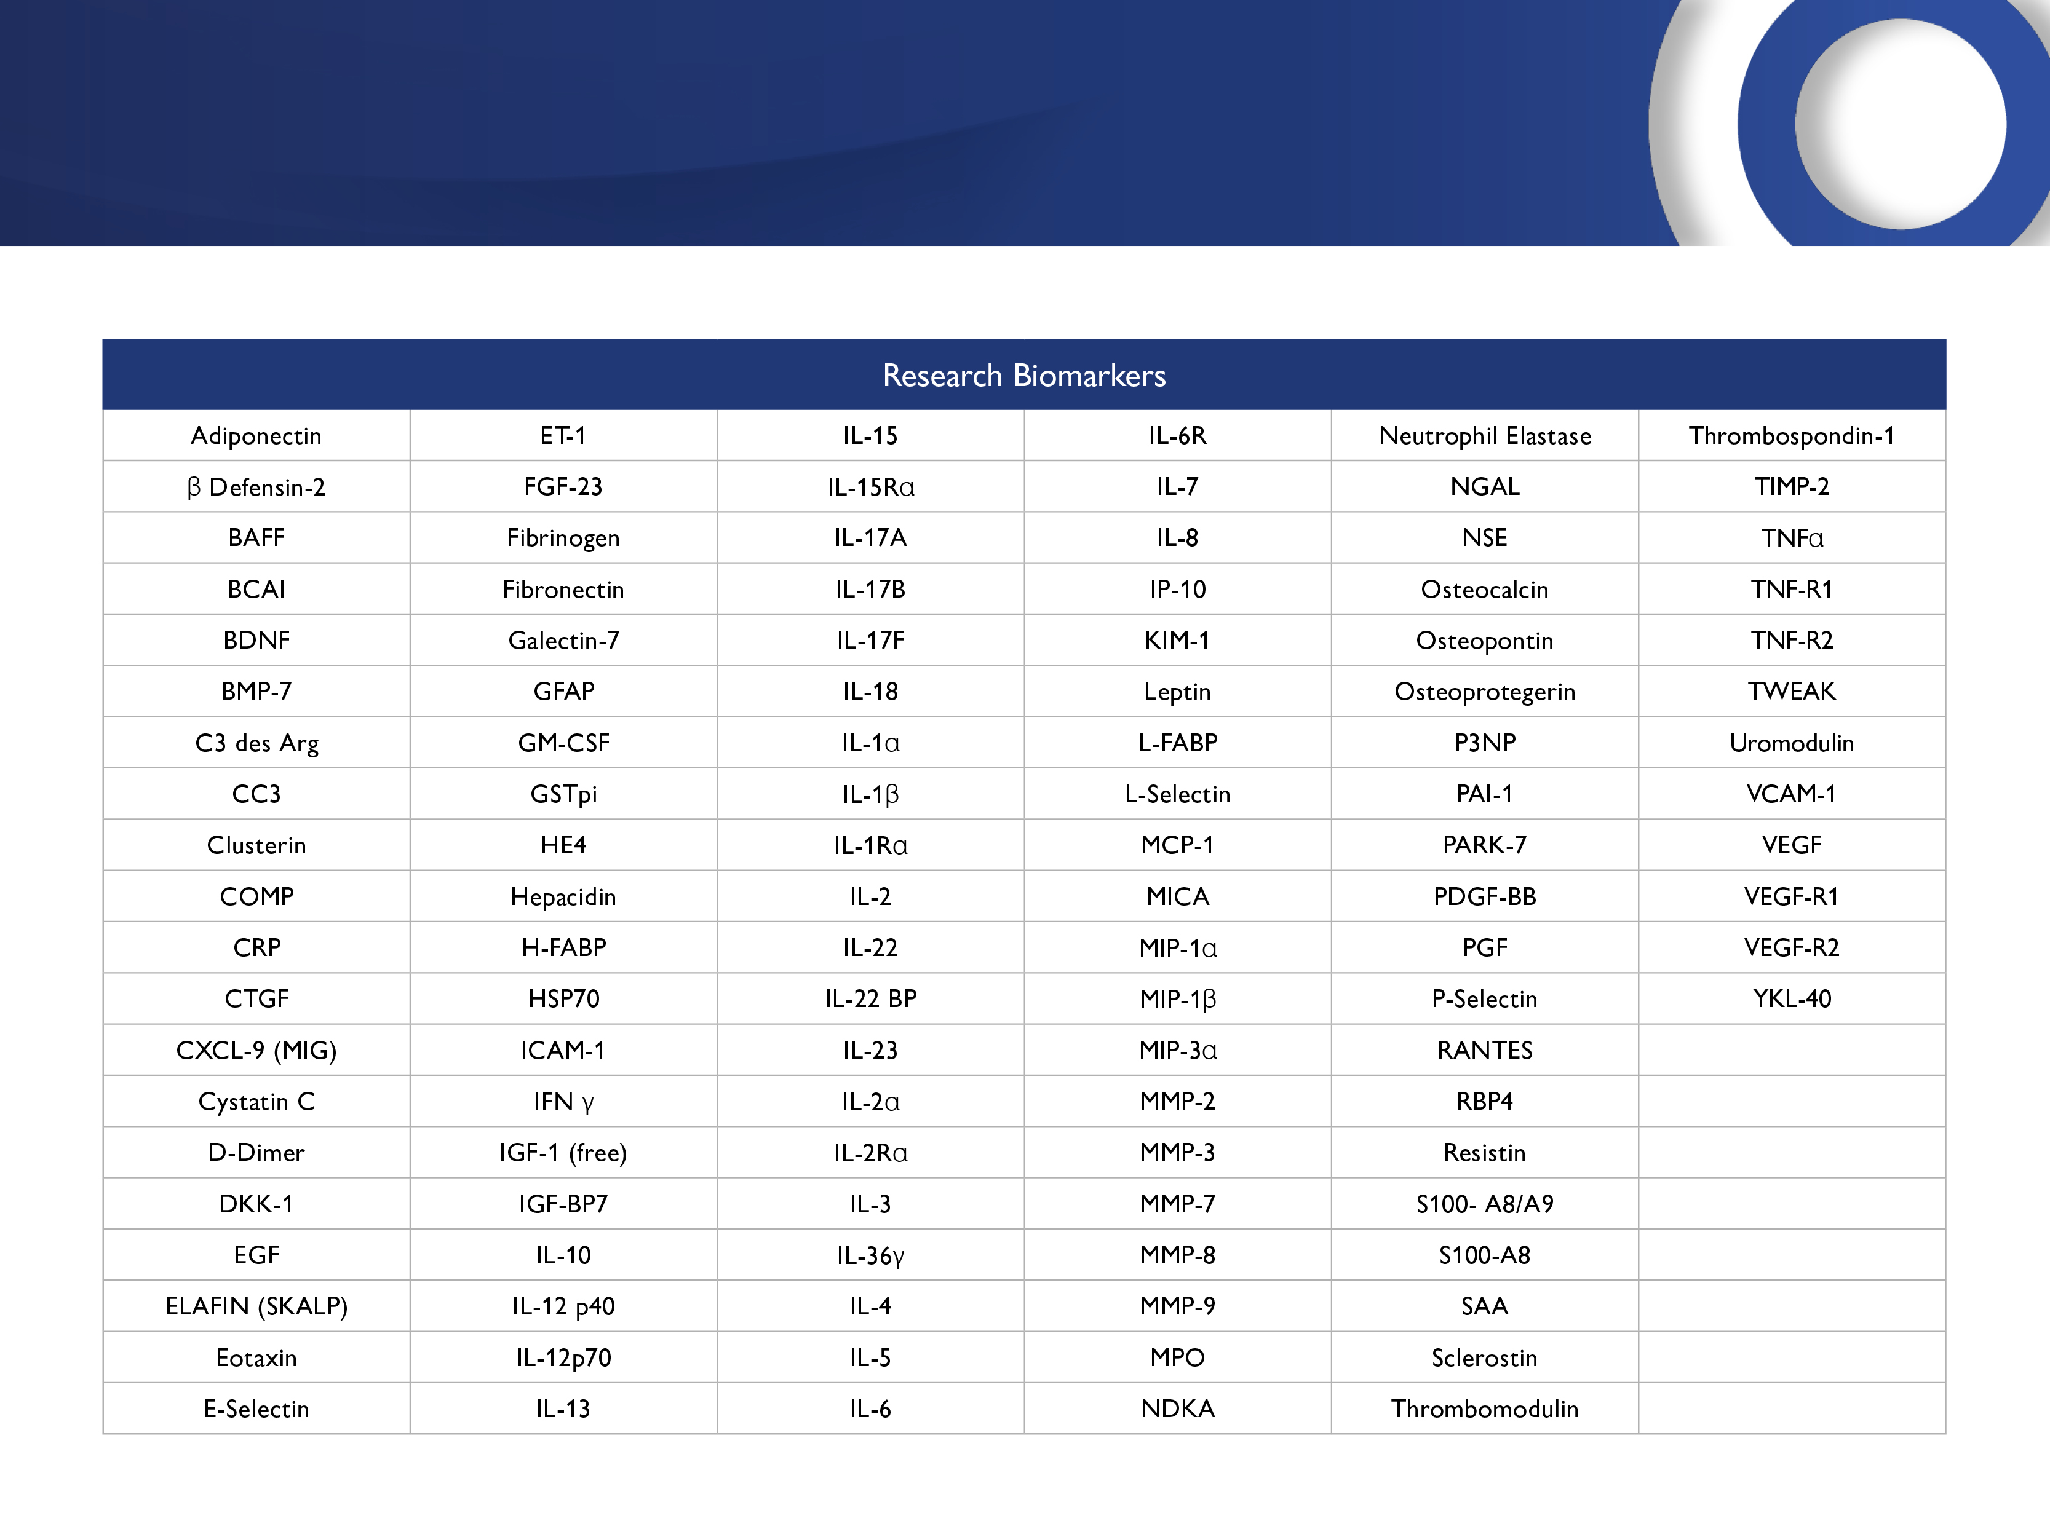
RANDOX

Slide 23
Stroke Biomarker Array
8-plex Stroke Biochip Array | Location – Pathophysiology indication | Assay range | Sensitivity
GSTP1 | Cytoplasmic neural and glial cells - Oxidative stress | 0-200 ng/ml | 0.8 ng/ml
PARK7 | Cytoplasmic neural and glial cells - Oxidative stress | 0-100 ng/ml | 0.4 ng/ml
NDKA | Cytoplasmic neural and glial cells - Ischemic cascade | 0-250 ng/ml | 5.3 ng/ml
GFAP | CNS astrocytes – Cytoplasmic stress | 0-20 ng/ml | 0.08 ng/ml
FABP3 | Cytoplasmic – Cellular damage | 0-100 ng/ml | 0.4 ng/ml
sTFNr1 | Systemic circulation - Inflammation | 0-250 pg/ml | 1.0 pg/ml
IL-6 | Systemic circulation – Inflammation | 0-10 ng/ml | 0.04 ng/ml
D-Dimer | Systemic circulation - Fibrinolysis | 0-2000 ng/ml | 8.0 ng/ml

Slide 24
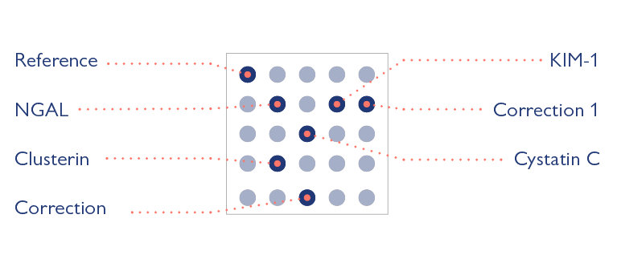
Biomarkers- Acute kidney injury
DIKI Array
NGAL
Cystatin C
Clusterin
KIM-1
Cat. No. EV4274
Parameter | DIKI
Immunoassay Type | Sandwich
Sample Matrix | Urine
Sample Volume | 100 µL of Diluted sample*
Sample Dilution | 1 in 10
 | *10 µL urine required

Slide 25

Randox Th-17 multiplex
BioMarker | Sensitivity
IL-17F | 1.00 pg/mL
IL-17A | 0.49 pg/mL
IL-22 | 0.10 pg/mL
IL-23 | 10 pg/mL

Slide 26
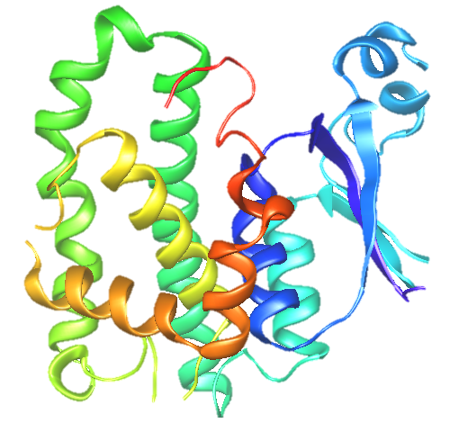
Questions & Initial feed-back

