Slide 1



Slide 2
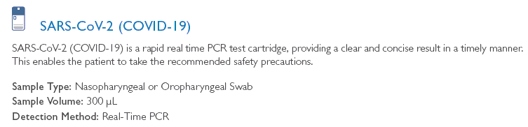
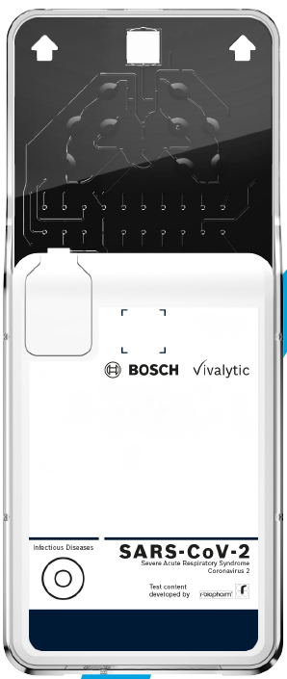
Accurate SARS-CoV-2 Testing in only
39 minutes!
A new breakthrough fully automated POC test for SARS-Cov-2 with results available in only 39 minutes.
Highly accurate with specificity at 95%

Slide 3
Randox Key Facts
Established in 1982
UK and Ireland’s largest diagnostic company
Randox manufactures 4 billion tests per year
5th largest manufacturer of Clinical Chemistry Reagents in the World
3rd largest manufacturer of Quality Control and Calibrators
The World’s Number One global proficiency testing/EQA supplier – RIQAS
The World’s largest toxicology test menu spanning over 400 drug assays
5% of world’s population diagnosed using Randox products
Significant OEM assay development & manufacture
5%
World
Population

Slide 4
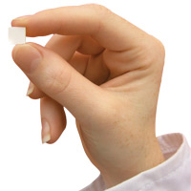
Biochip Array Technology
One sample, multiple results
All of Randox’s testing solutions for Covid-19 are powered by our patented Biochip technology.
Biochip Array Technology allows simultaneous detection of multiple analytes from a single sample.
Main Features
A chemically activated 9x9mm ceramic chip
Currently 49 discrete test regions (includes 3 internal control/reference spots)
Offers more flexible batch sizes than traditional ELISA plate testing

Slide 5
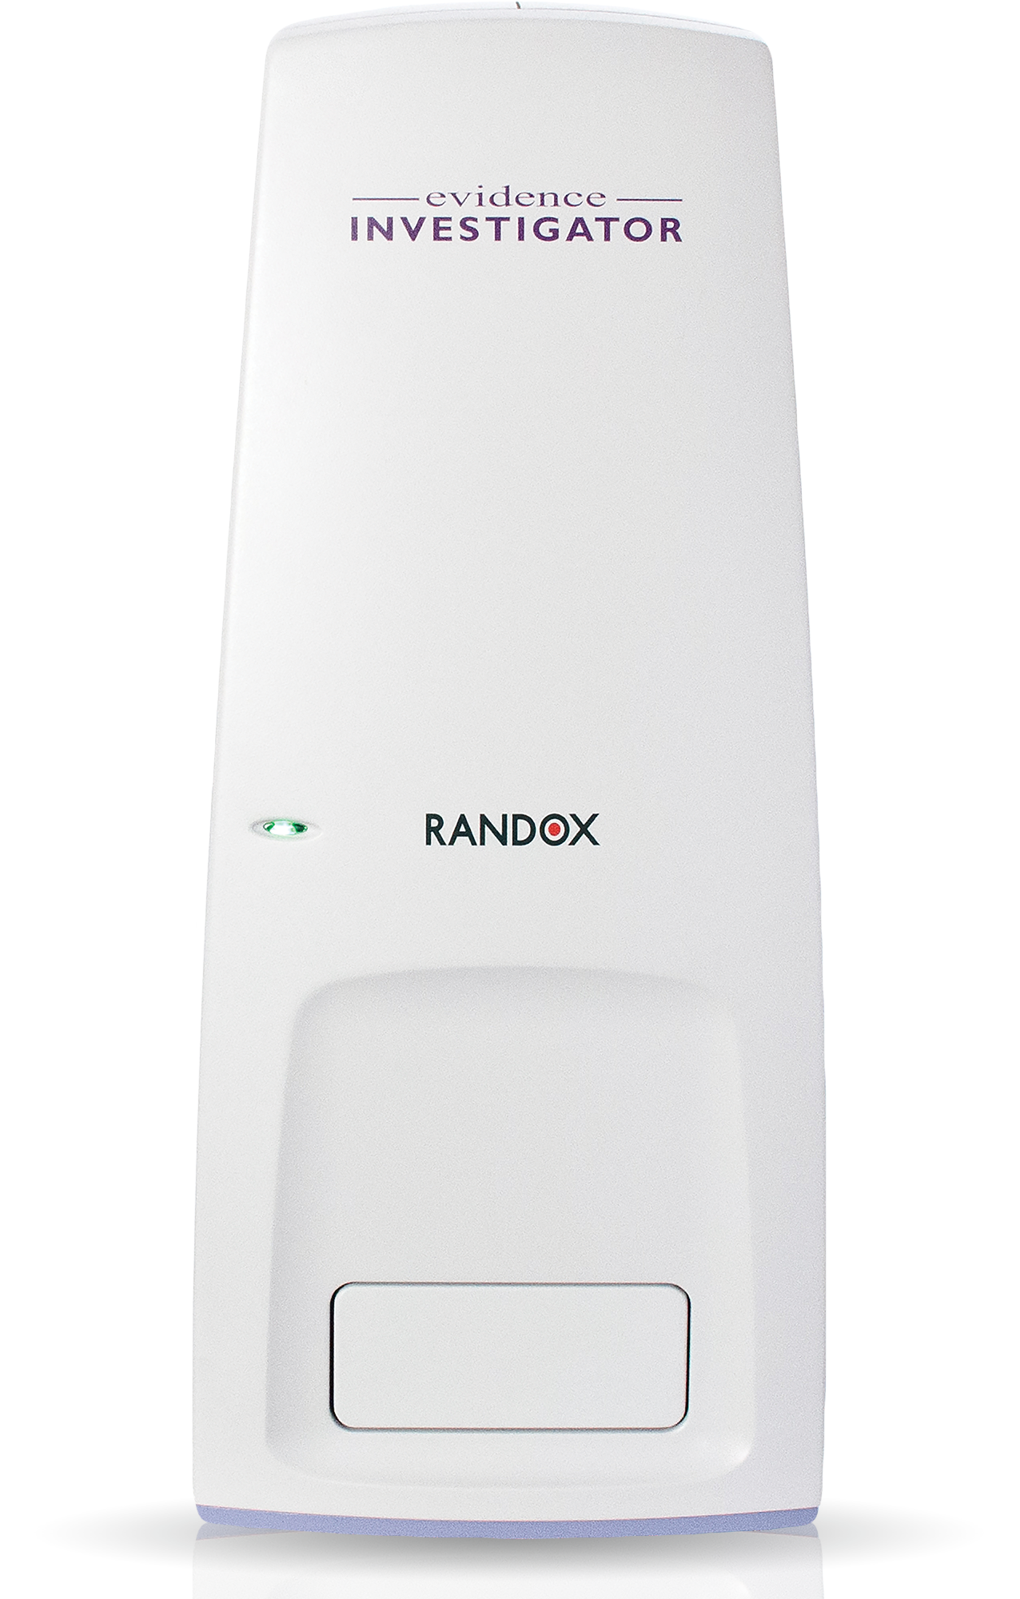
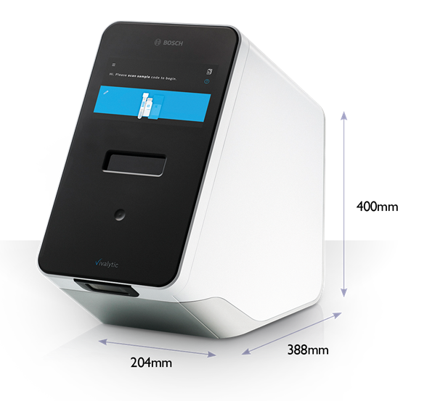
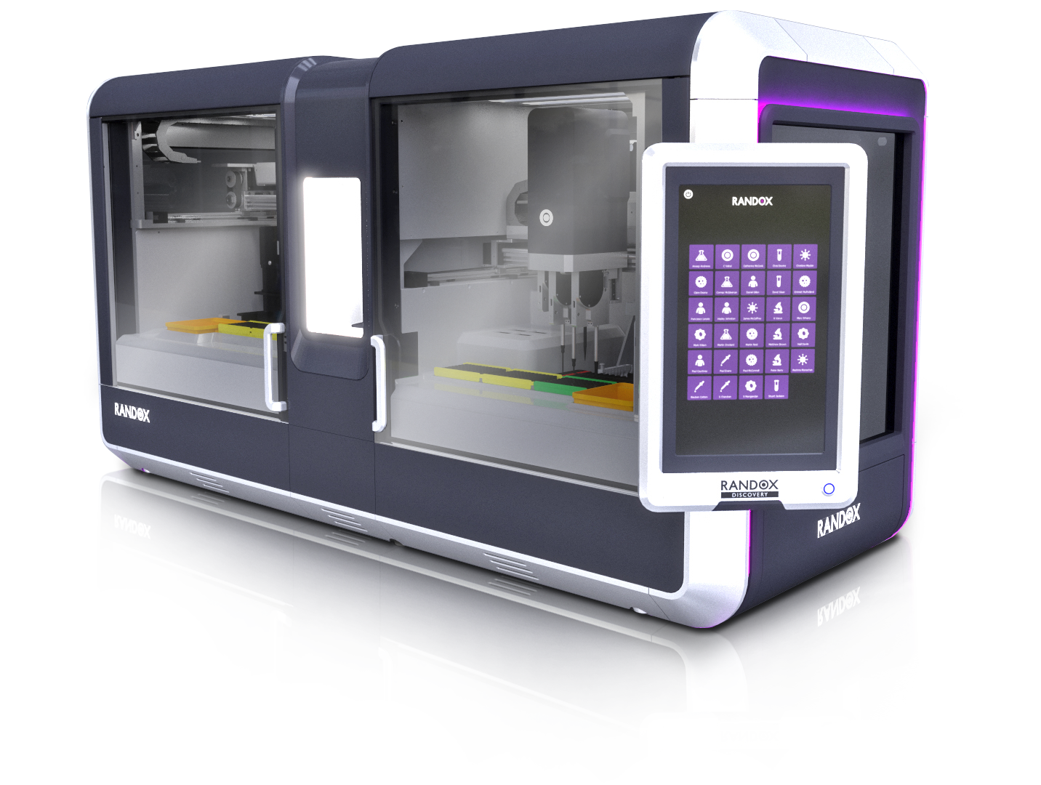
SARS-CoV-2 Testing Summary
Randox Laboratories have developed a rapid test for SARS-CoV-2 (COVID-19) across a number of platforms.
E.Investigator
Vivalytic
Discovery
950mm
1835mm
730mm
750 (H) x 480 (D) x 420 (W) mm
Semi-Automated
Time to result 5 hours
108 samples per run
SARS-CoV-2 specific assay and 10-plex RVI assay available.
Fully automated POC
SARS-CoV-2 Rapid test reporting results in 39 mins
SARS-CoV-2 specific assay and 10-plex RVI assay available. (2 hours)
1 sample per run
Pooling of samples possible (up to 5) in the SARS-CoV-2 Rapid test
Fully automated
3 hours to first result and every hour thereafter
16 samples per batch run
SARS-CoV-2 specific assay and 10-plex RVI assay available.

Slide 6
SARS-CoV-2 Test Options
Randox have also developed both specific and extended testing solutions for Covid-19.
Our extended Viral Respiratory Array (VRI) provides a more comprehensive respiratory assessment from a single patient sample while our specific Covid-19 array offers a quick and specific test for Covid-19.
For Covid-19 testing the panels Incorporate two genomic regions of the SARS-CoV-2 viral genome as per WHO recommendations.
  Gene E is used as a screening test to detect Sarbecovirus (SARS, SARS like & SARS-CoV-2).
  ORF1ab is used as a specific test to confirm the presence of SARS-CoV-2.
SARS-CoV-2 Rapid Test
SARS-CoV-2 (COVID-19)
(Extended) Respiratory Viral Infection Array
SARS-CoV-2 (COVID-19) | Adenovovirus A/B/C/D/E
Sarbecovirus (SARS, SARS like, SARS-CoV-2) | Enterovirus A/B/C
Coronavirus 229E/NL63 | Influenza A
Coronavirus OC43/HKUI | Influenza B
Middle East Respiratory Syndrome Coronavirus (MERS-CoV) | Rhinovirus A/B

Slide 7
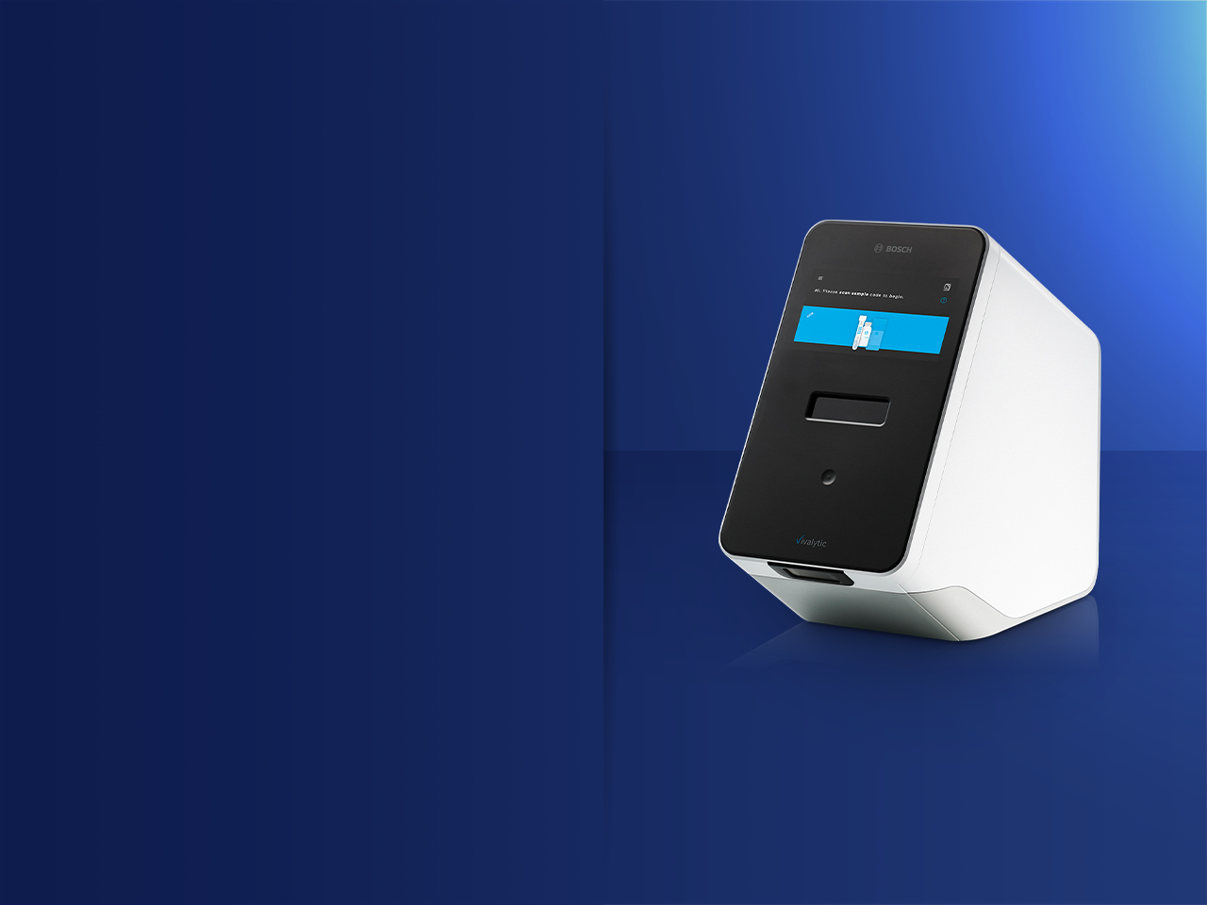


VIVALYTIC
THE ALL IN ONE MOLECULAR SOLUTION

Slide 8
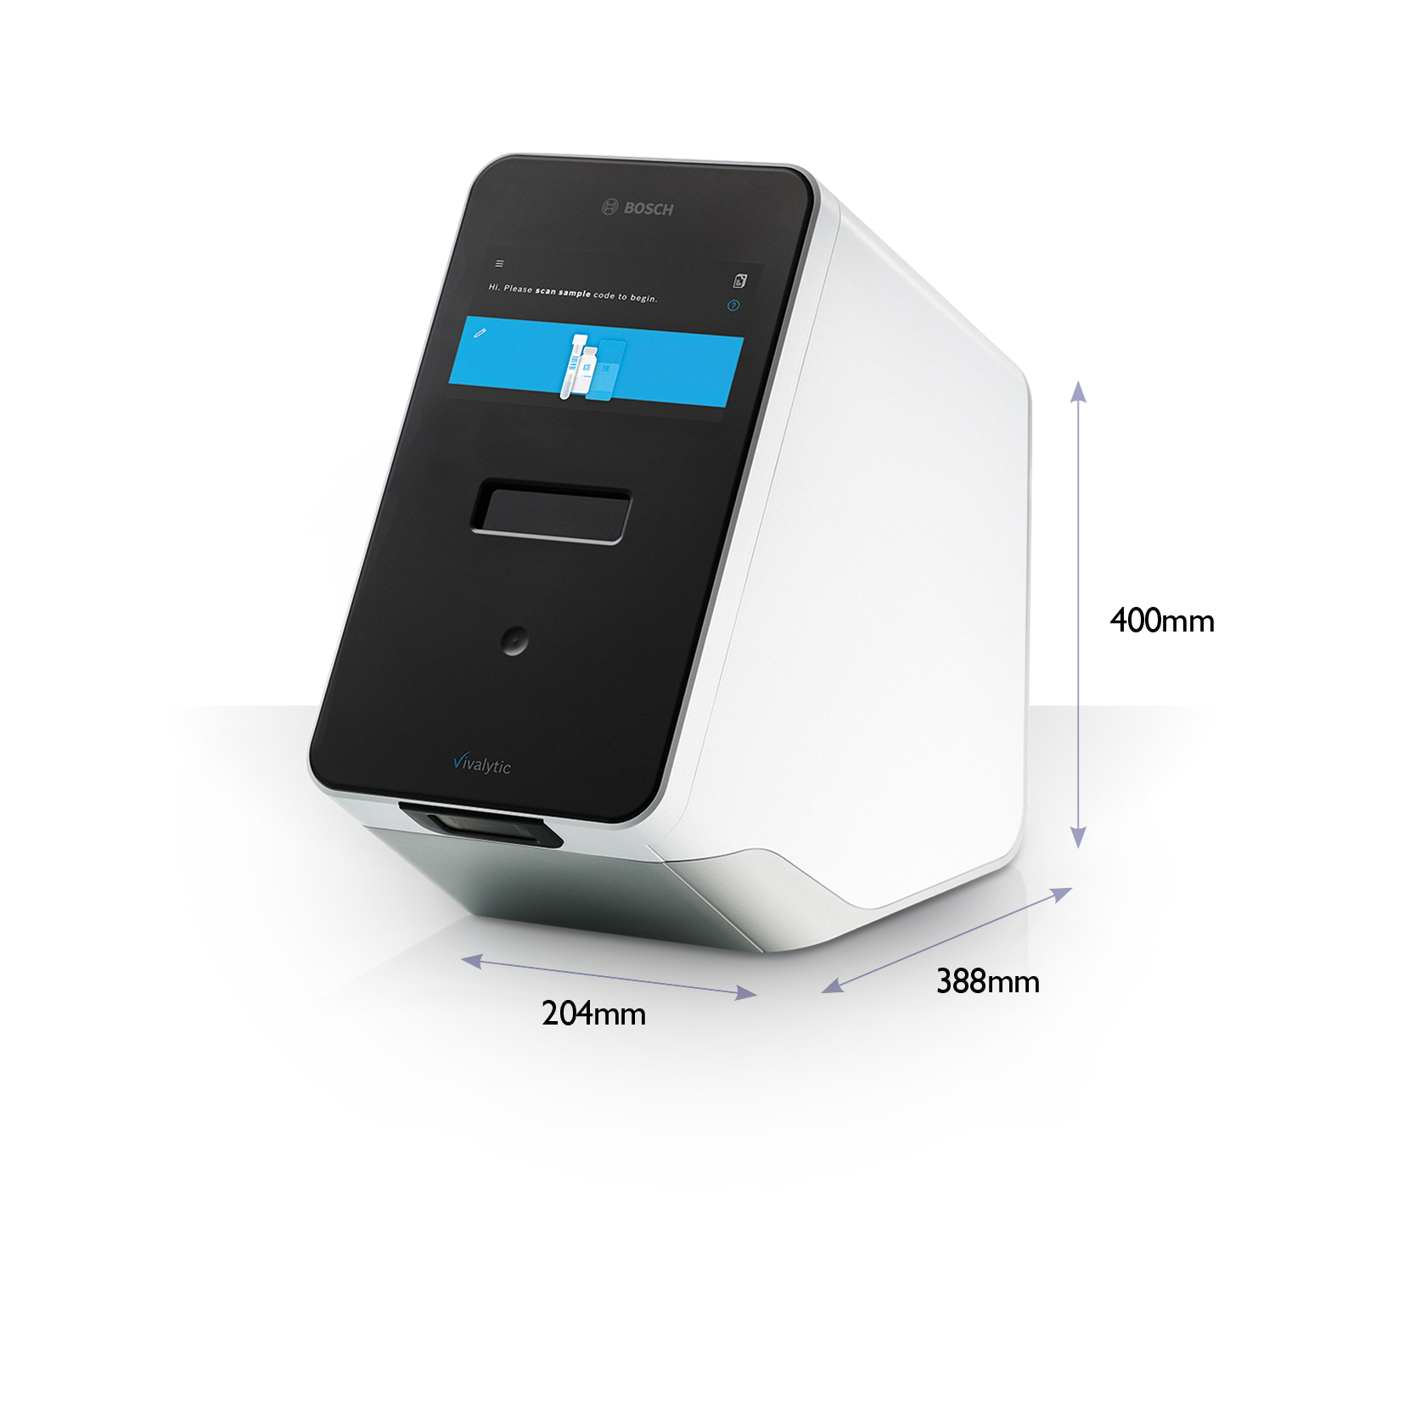
Vivalytic
One Device, Many Benefits
Fully Automated Molecular Platform
Vivalytic is capable of nucleic acid extraction, PCR, amplification and detection
Reduces the workflow of 4 laboratory rooms into one platform
Standalone Platform
No peripherals such as a laptop, keyboard or barcode scanner are required
No Laboratory Training Required
Vivalytic is a simple, easy to use platform which requires four simple user steps
  Scan sample code
  Scan cartridge code
  Input sample into cartridge & close cover
  Insert cartridge into Vivalytic

Slide 9
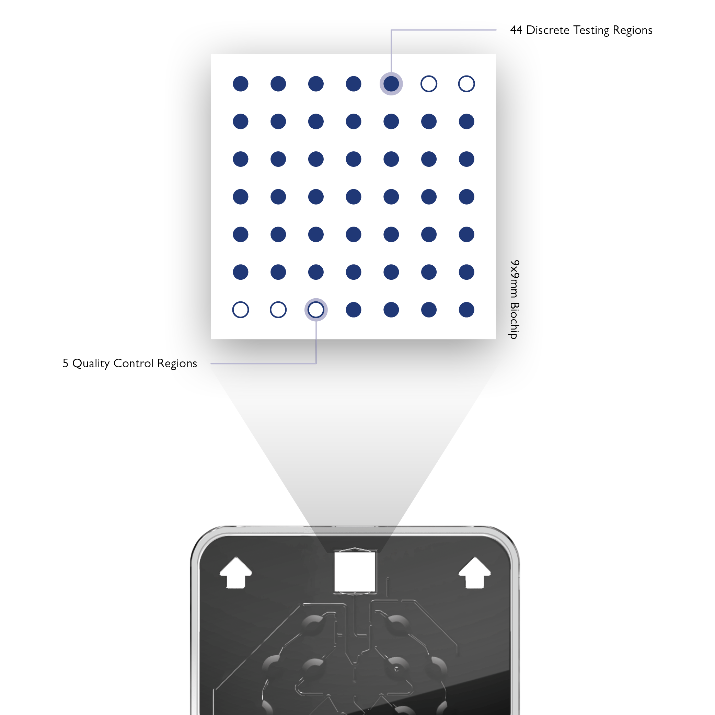
Vivalytic
Powered by Randox Biochip Technology
Biochip Array Technology allows simultaneous detection of multiple analytes from a single sample.
Main Features
A chemically activated 9x9mm ceramic chip
Currently 49 discrete test regions (includes 3 internal control/reference spots)
Offers more flexible batch sizes than traditional ELISA plate testing due to multiplexing.

Slide 10
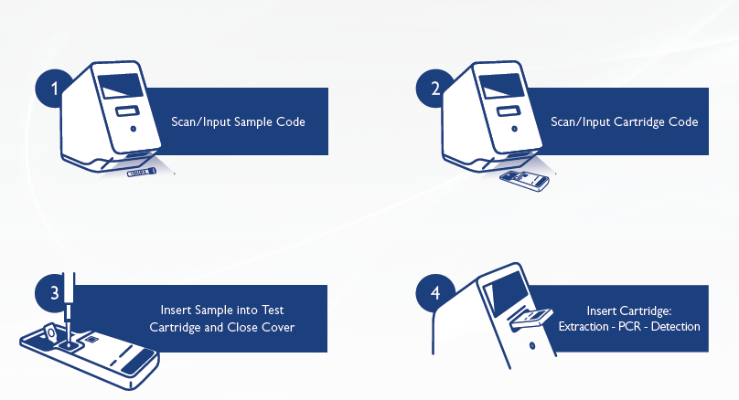
Vivalytic Worfklow

Slide 11
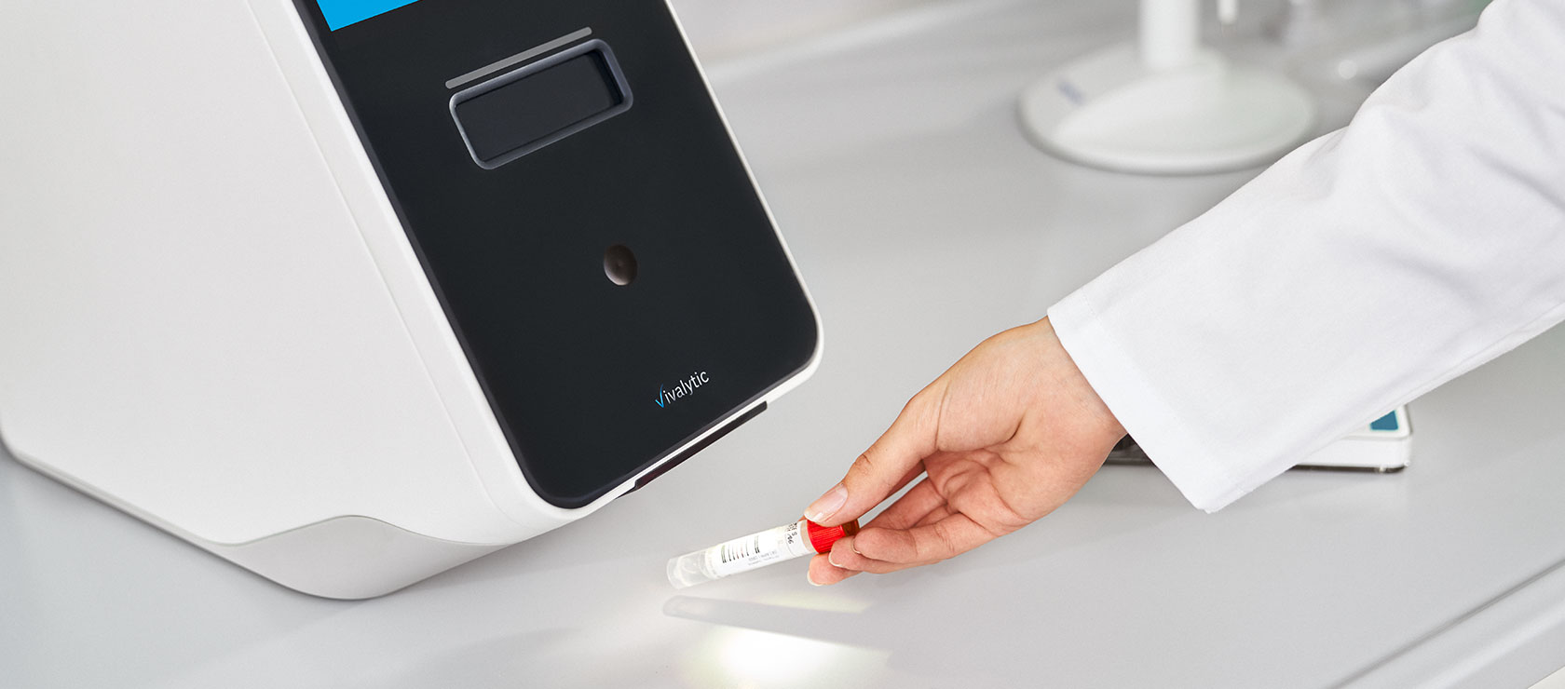

Slide 12
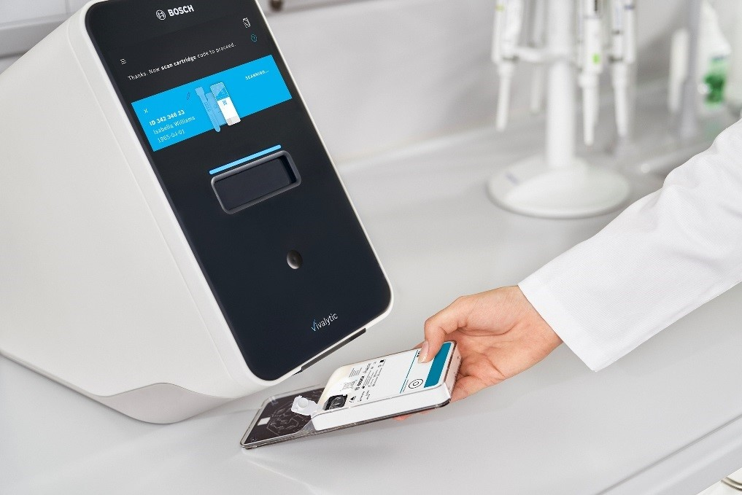

Slide 13
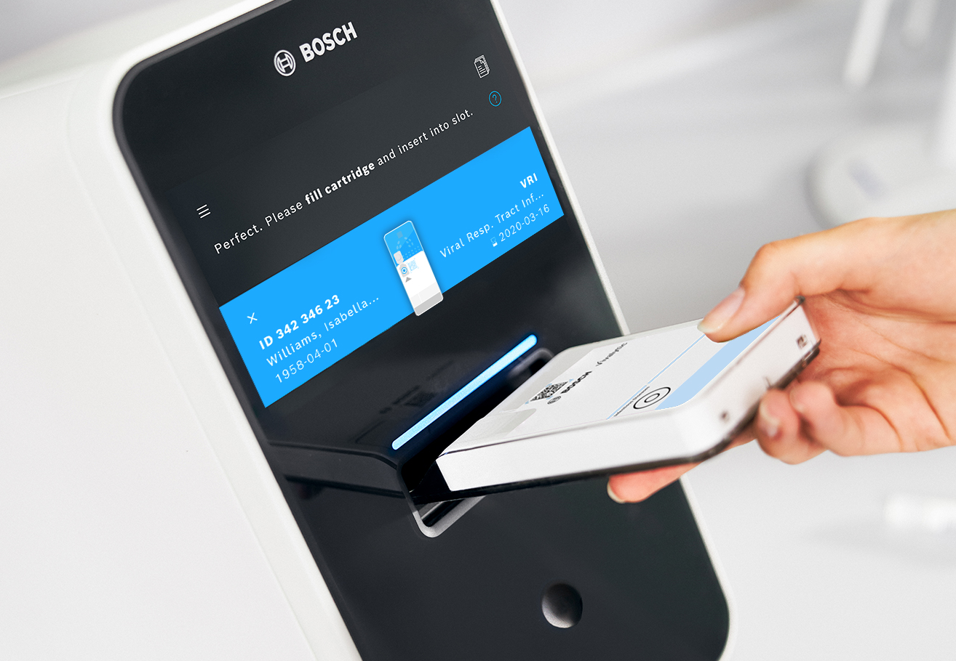

Slide 14
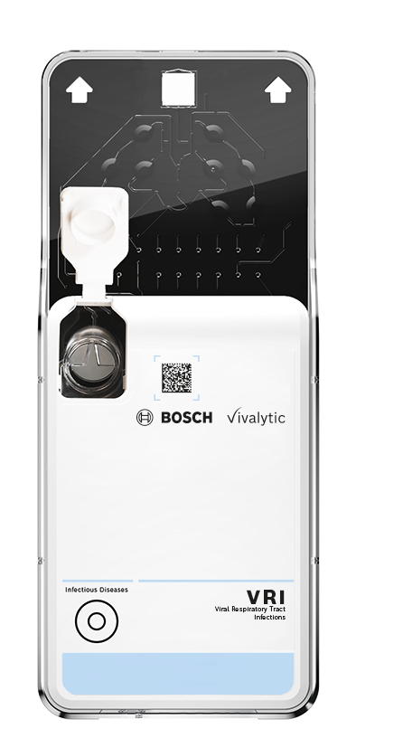
SARS-CoV-2 Test Options
Sample Type: Nasopharyngeal Swab
Sample Volume: 300μl Clinical Sample
Result Time: 39 minutes (Rapid Test)
2.5 Hours (1st generation Sars-Cov-2 test and extended VRI array)
SARS-CoV-2 Rapid Test
SARS-CoV-2 (COVID-19)
(1st Gen) SARS-CoV-2 Test
SARS-CoV-2 (COVID-19) & Sarbecovirus (SARS, SARS like, SARS-CoV-2)
(Extended) Respiratory Viral Infection Array
SARS-CoV-2 (COVID-19) | Adenovovirus A/B/C/D/E
Sarbecovirus (SARS, SARS like, SARS-CoV-2) | Enterovirus A/B/C
Coronavirus 229E/NL63 | Influenza A
Coronavirus OC43/HKUI | Influenza B
Middle East Respiratory Syndrome Coronavirus (MERS-CoV) | Rhinovirus A/B

Slide 15
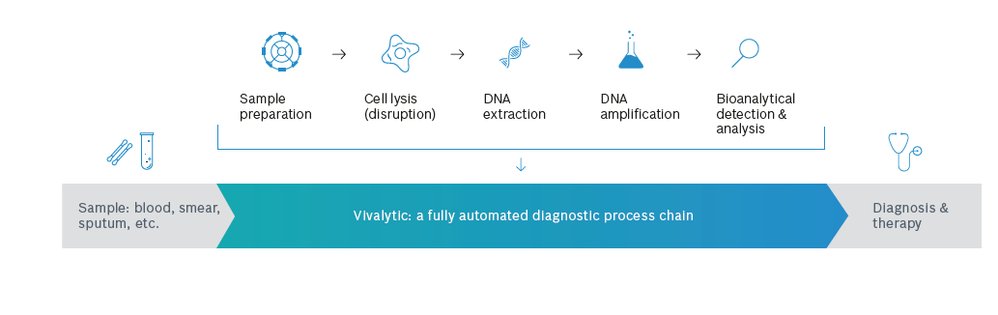
Vivalytic
Fully Automated Molecular Workflow
Vivalytic condenses the work of four laboratory rooms into one point of care platform
Vivalytic reduces the time to result significantly to as low as 39 minutes
Vivalytic is a standalone platform that requires no laboratory training

Slide 16
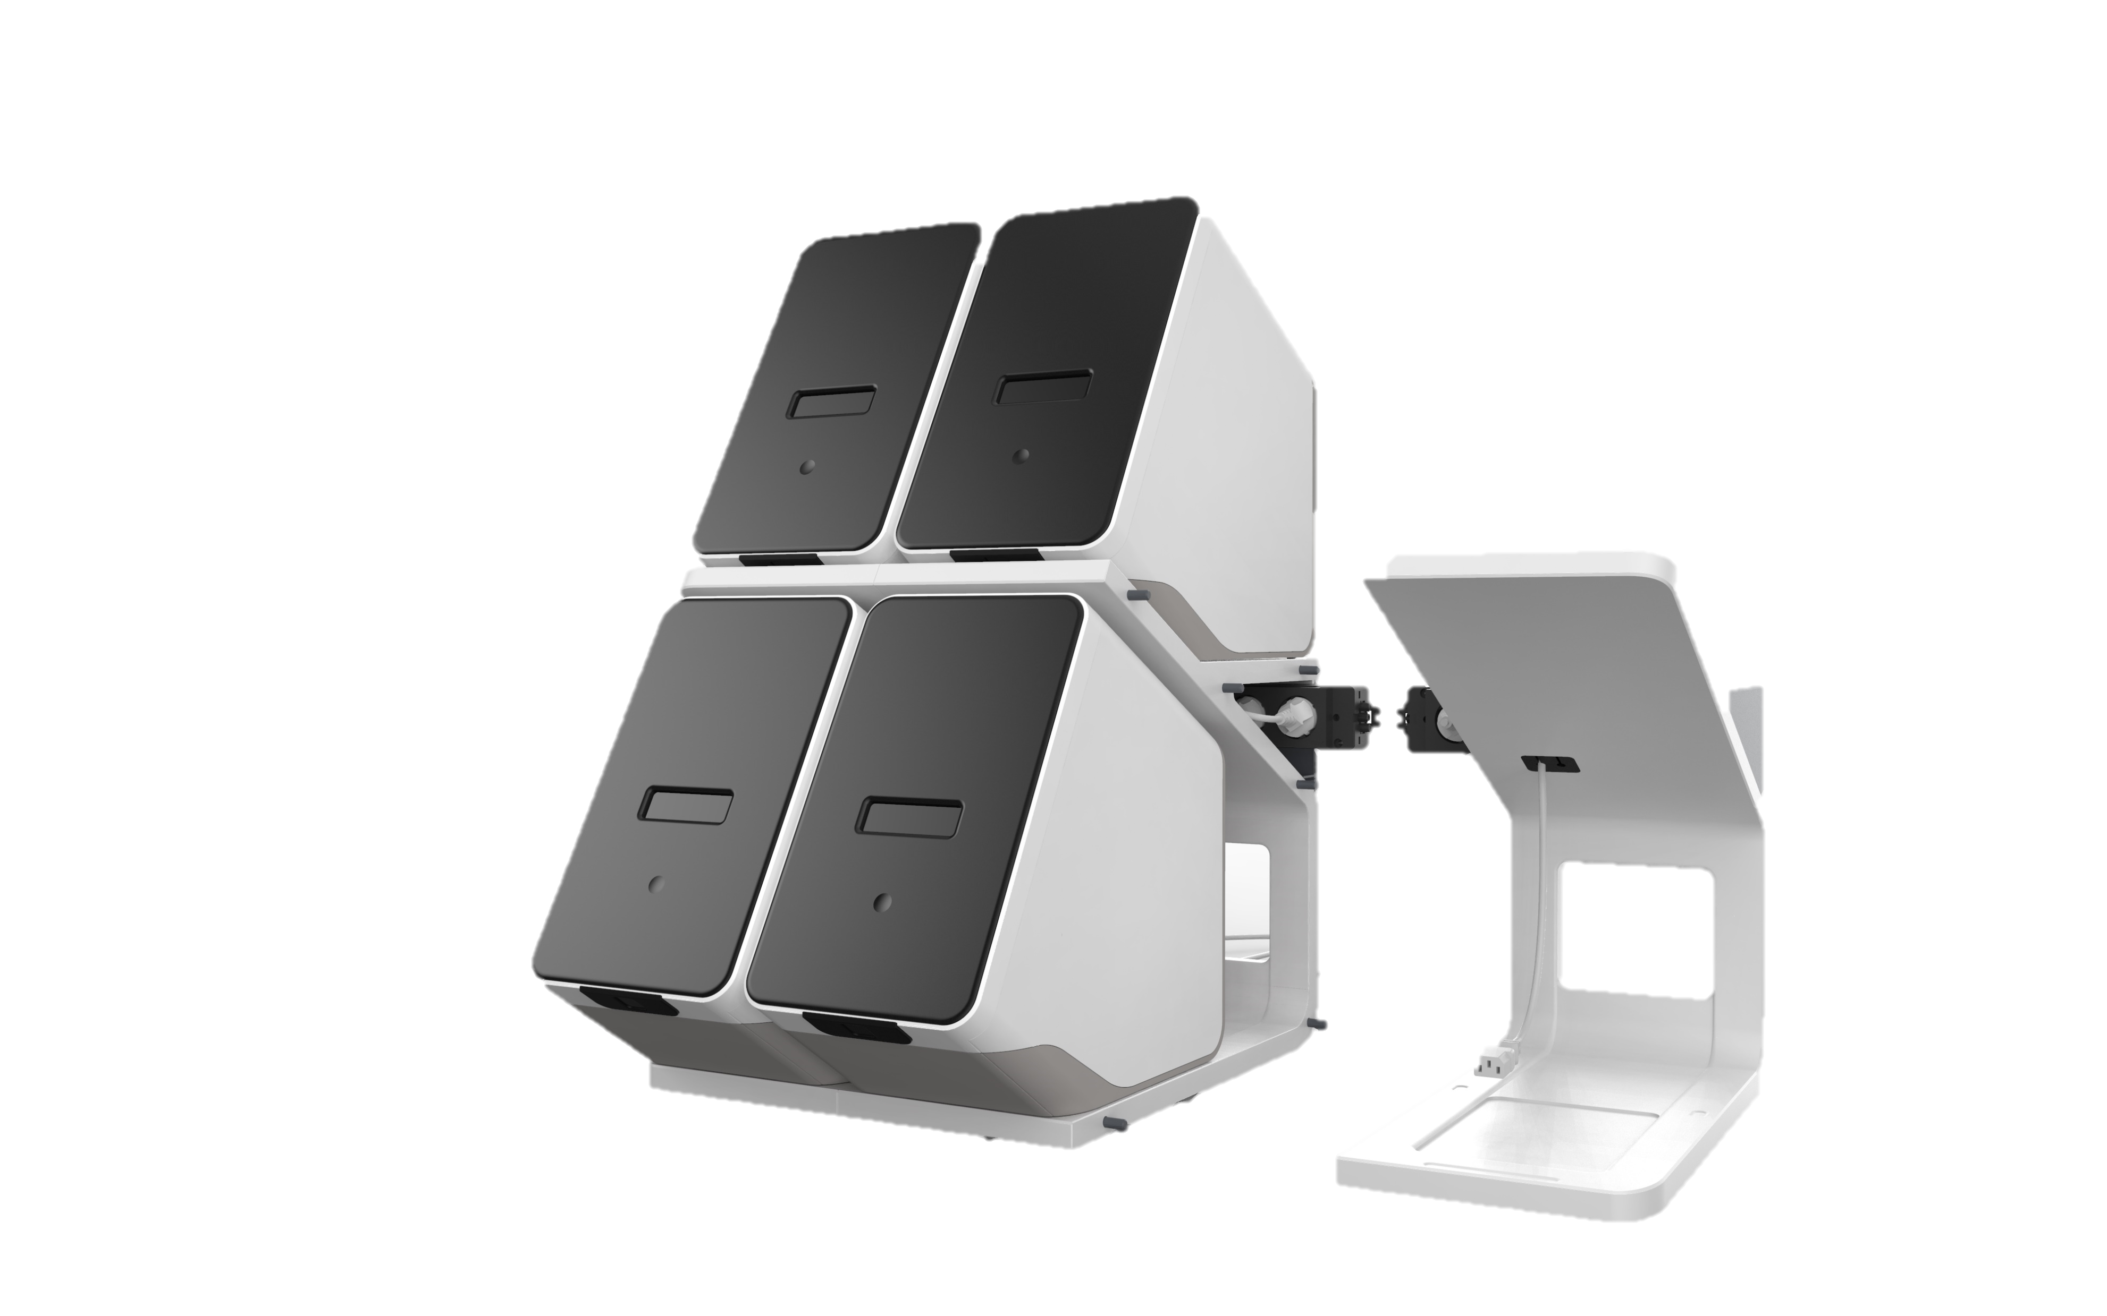
Vivalytic Up
Vivalytic is a versatile analyser suitable as a stand-alone platform. Alternatively, it can be transformed into a modular and
expandable system. Stacking of the analysers provides the user with a scalable, flexible and space saving
Molecular Diagnostic testing solution.
Vivalytic Up offers a multi-slot, random access testing platform allowing the user the ability to use one analyser as the master user-interface that communicates with the other analysers.
Integrated cable management is available allowing just one main power cable to power up to 8 analysers at one time.

Slide 17

RANDOX DISCOVERY
The Benchtop Molecular Lab

Slide 18
SARS-CoV-2 Test Options
Sample Type: Nasopharyngeal Swab
Sample Volume: 300μl Clinical Sample
Result Time: 3 hours to first result (16 samples) and every hour thereafter
SARS-CoV-2 Test
SARS-CoV-2 (COVID-19) & Sarbecovirus (SARS, SARS like, SARS-CoV-2)
(Extended) Respiratory Viral Infection Array
SARS-CoV-2 (COVID-19) | Adenovovirus A/B/C/D/E
Sarbecovirus (SARS, SARS like, SARS-CoV-2) | Enterovirus A/B/C
Coronavirus 229E/NL63 | Influenza A
Coronavirus OC43/HKUI | Influenza B
Middle East Respiratory Syndrome Coronavirus (MERS-CoV) | Rhinovirus A/B

Slide 19





The Randox Discovery is an exciting and revolutionary molecular diagnostic testing technology.
The fully automated benchtop multiplex analyser consolidates the normal workload of multiple laboratory rooms into one compact benchtop platform
FULLY AUTOMATED
3 HOURS TO FIRST RESULT
WORK CONSOLIDATION
HIGH THROUGHPUT
BENCHTOP
The system utilises ready to use cartridge based prefabricated reagents. Up to 16 patient samples can be run in a single batch. Discovery is powered by Randox Biochip Technology, enabling multiple targets to be detected simultaneously in each specimen. First results are reported after 3 hours, and every hour thereafter.

Slide 20
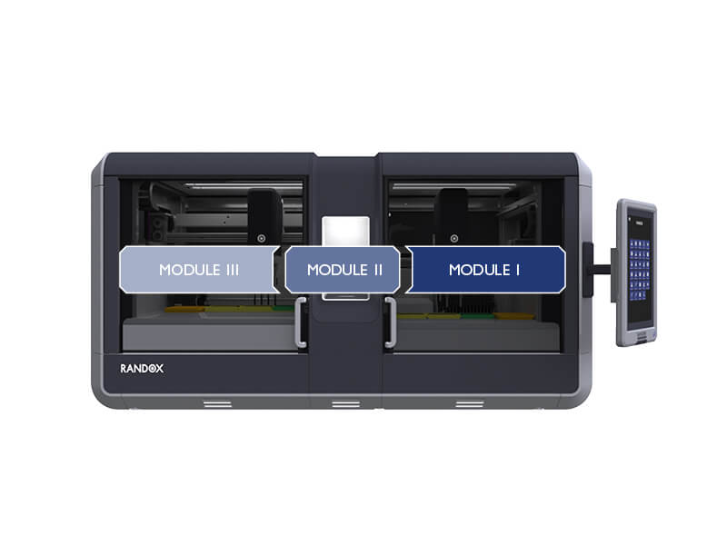
Fully Automated Molecular Workflow
The machine is comprised of three interconnected modules with the first module performing sample extraction and purification, the second conducting multiplex PCR and the third module managing biochip hybridisation and detection.
Zone III - Hybridisation & Detection (Biochip)
Zone I - DNA/RNA Extraction
Zone II – Amplification (PCR)

Slide 21
Randox Discovery Automated Workflow
Zone I, II & III
Three zones
Each zone works independently
Each zone is accessible by a door
Work flow runs from right to left
The product of each zone is a stable sample, reducing the risk of sample quality degradation during automated processing
Each zone is separated by a physical barrier, and air flow is directed from the deck level to the roof of the analyser using filtered fans to control transfer of contaminant aerosols between zones
Contamination between zones is controlled by design, allowing the user to run different sets of samples and different assay types on each zone at one time, increasing throughput

Slide 22
Randox Discovery
Touchscreen
The touchscreen can be mounted to left or right sides of the analyser. The preference is advised by the user at point of manufacture.
Speakers allow the software to advise the user audibly
A USB port allows the user to retrieve results
The power button that controls the power to the analyser is located here – press once to turn the machine on, press and hold for 3s to send the analyser to standby low-power mode
A barcode scanner mounted on the underside of the HMI scan cartridge and sample barcodes
USP’s
The service drawer means the machine does not have to be moved during service, reducing the time, tools and personnel required for a service visit
Contamination between zones is controlled by design, allowing the user to run different sets of samples and different assay types on each zone at one time, increasing throughput
The HMI is a standalone computer, which removes the risk of user interactions or user queries from influencing the automated execution of the assay, maximising repeatability between tests
The analyser automatically checks and advises if there are not enough consumables on the deck to complete the requested Batch Run, before the run starts. This reduces the risk of lost sample due to analyser setup.

Slide 23
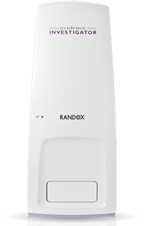
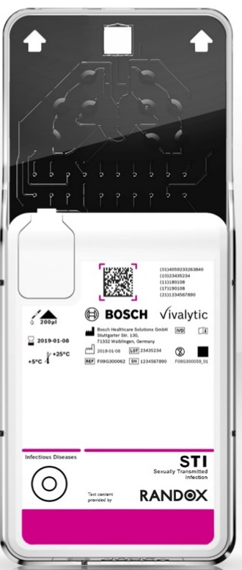
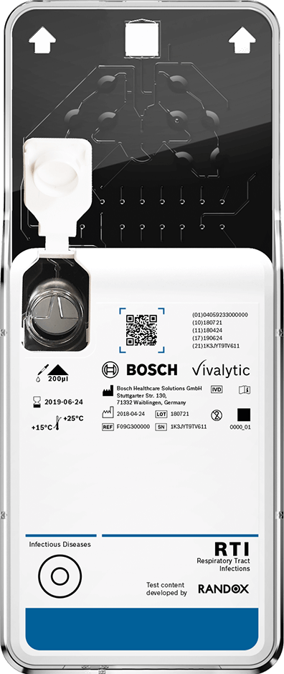
Molecular Test Menu
Genitourinary
Evidence Investigator
Sexually Transmitted Infection Array
10-Plex
Urinary Tract Infection Array
30-Plex

Slide 24
SARS-CoV-2 Test Options
Sample Type: Nasopharyngeal Swab
Sample Volume: 300μl Clinical Sample
Result Time: 108 samples in 5 Hours
SARS-CoV-2 Test
SARS-CoV-2 (COVID-19) & Sarbecovirus (SARS, SARS like, SARS-CoV-2)
(Extended) Respiratory Viral Infection Array
SARS-CoV-2 (COVID-19) | Adenovovirus A/B/C/D/E
Sarbecovirus (SARS, SARS like, SARS-CoV-2) | Enterovirus A/B/C
Coronavirus 229E/NL63 | Influenza A
Coronavirus OC43/HKUI | Influenza B
Middle East Respiratory Syndrome Coronavirus (MERS-CoV) | Rhinovirus A/B

Slide 25
Evidence Investigator
Benefits of the Multiplex Array
Simultaneously screens for 10 viruses including COVID-19 from 1 sample.
2 separate tests for COVID-19 and simultaneously screens for 8 other viruses with similar symptoms.
Low sample volume required.
108 patient samples can be processed in just 5 hours.
Differentiates between COVID-19 and other respiratory viruses for effective isolation & de-isolation of suspected and confirmed cases.

Slide 26
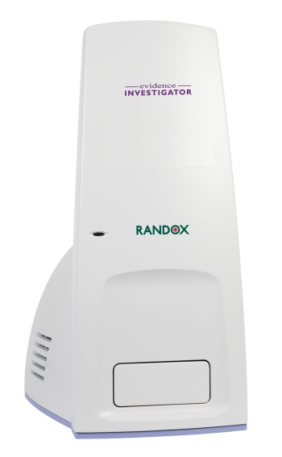
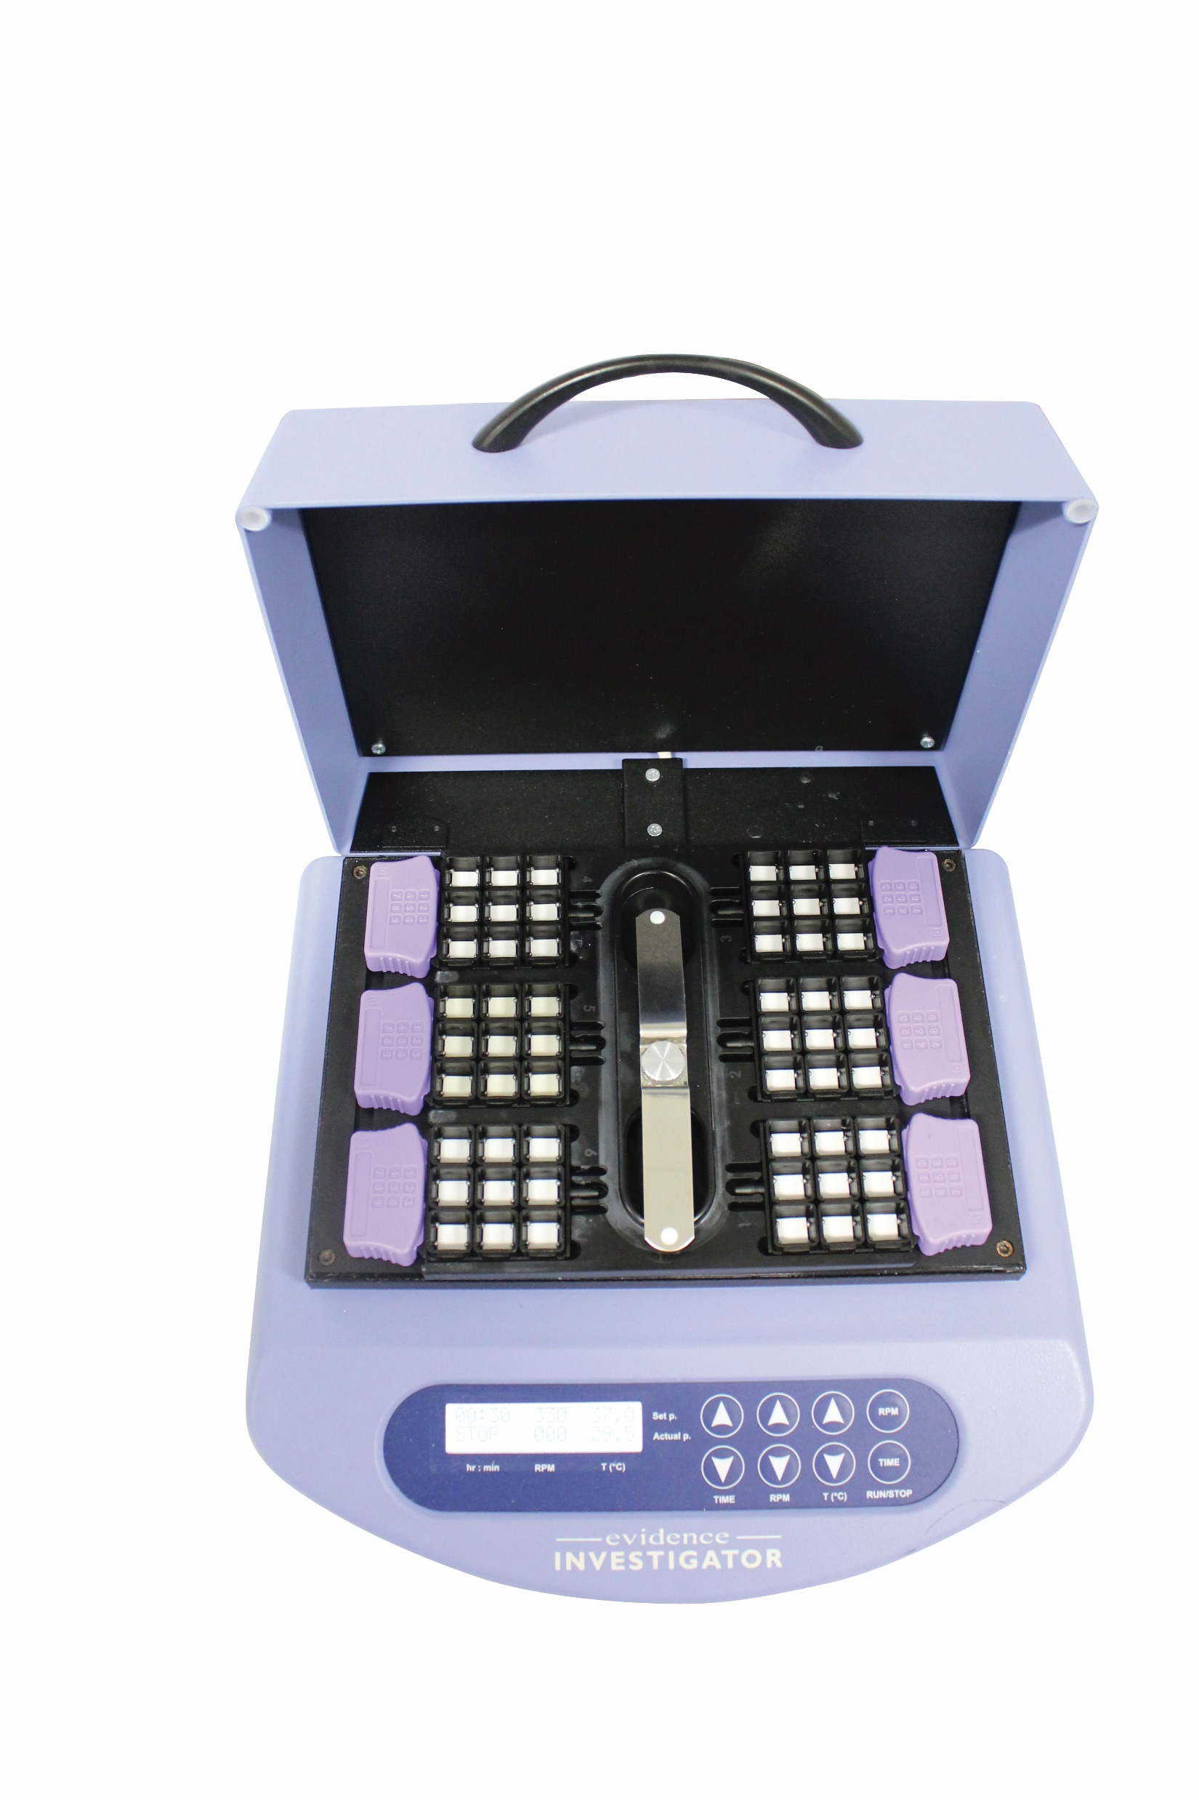
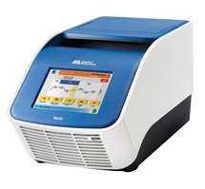
Molecular Diagnostic Package
Randox ‘Evidence Investigator biochip analyser
CE marked instrument
  conforms to EN61010-1: 2001; EN61010-2-101: 2002; EN61326:1997; A1:1998.
Includes 2 x thermoshaker units for hybridisation and conjugation and a Veriti™ Dx Thermal Cycler

Slide 27
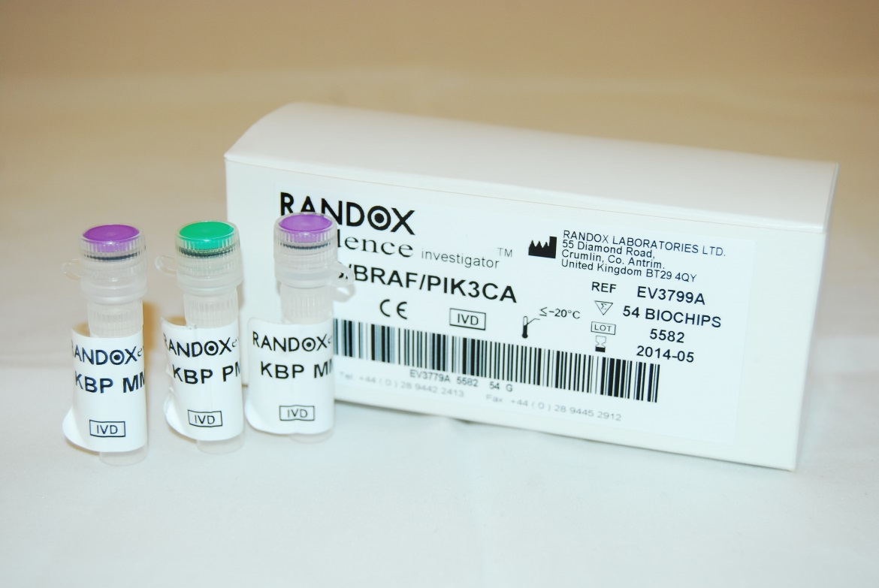
Evidence Investigator
Kits consists of parts A & B.
Part A: PCR reagents shipped on dry ice
Multiplex primer mix
Taq PCR Master Mix

Slide 28
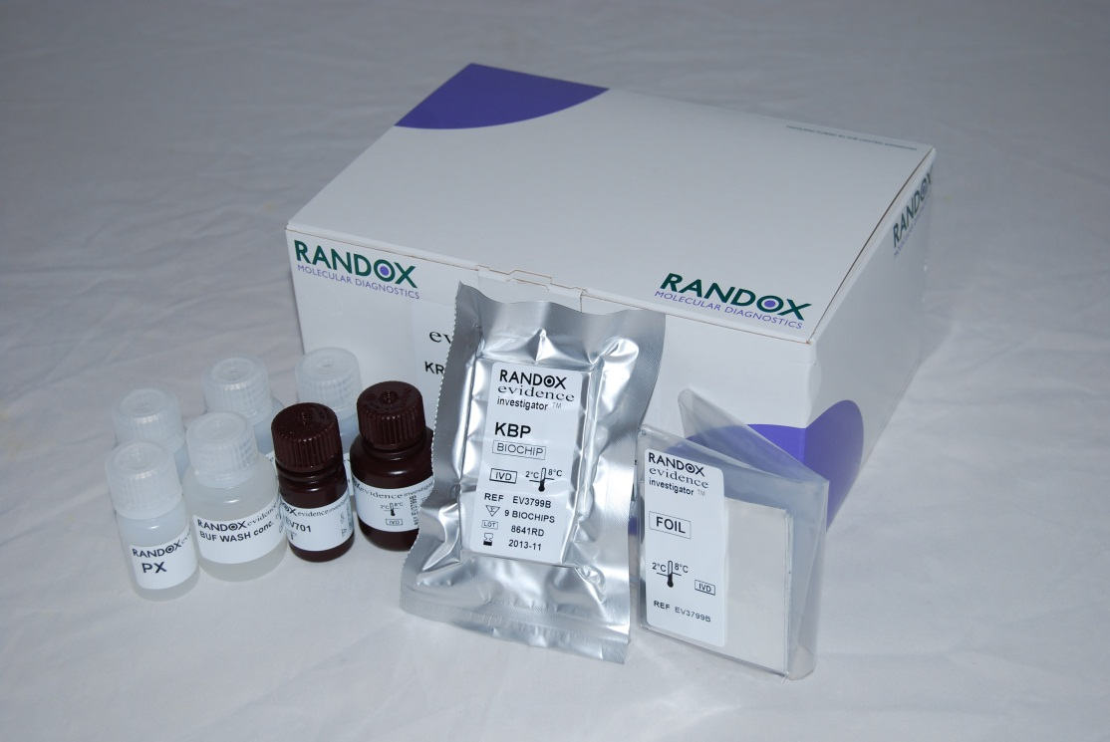
Evidence Investigator
Part B: Biochip carriers foil sealed
Assay wash buffers, conjugate, luminol and peroxidase reagents necessary to complete the array from extracted nucleic acid

Slide 29








Principles & Procedure
Amplified samples are added to biochips allowing target gene sequences to hybridise to complementary probes spotted on specific regions of the biochip surface.
Each biochip is then imaged on the Evidence Investigator where on-board software will identify the presence of respiratory pathogens within the sample.
An extraction control (EC) is incorporated into the array which confirms successful sample nucleic acid extraction and PCR amplification.
1. Nucleic Acid Extraction
2. Multiplex PCR
3. Hybridisation
4. Wash Step
5. Conjugation
6. Wash Step
7. Signal Reagent
8. Signal Detection
9. Result Report

Slide 30
Randox provides solutions across the entire spectrum of covid-19 testing
Randox Covid-19
POC
Near Patient
Home Testing
Low and high plex assays
Flexible options
High throughout
Corporate Testing
QC

Slide 31



