Slide 1
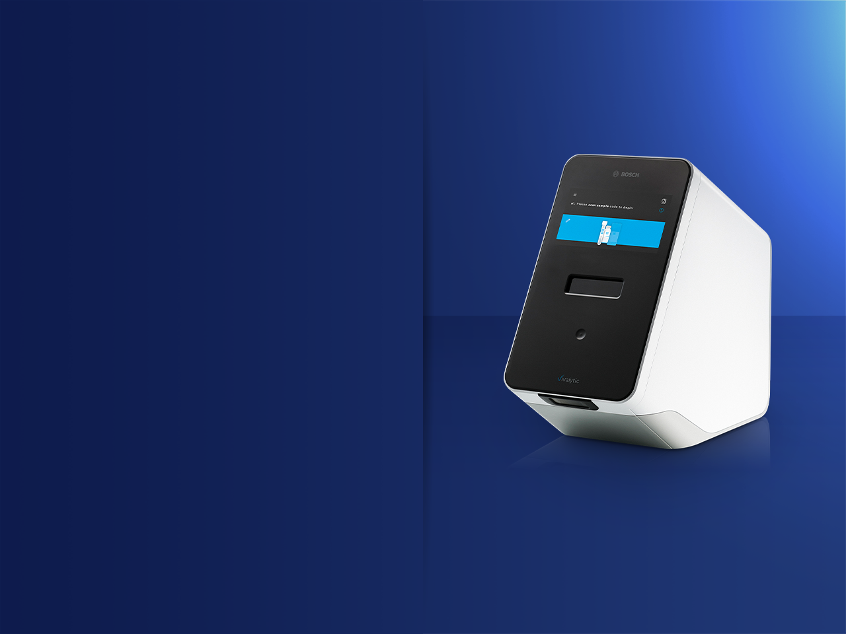
VIVALYTIC
THE ALL IN ONE MOLECULAR SOLUTION

Slide 2
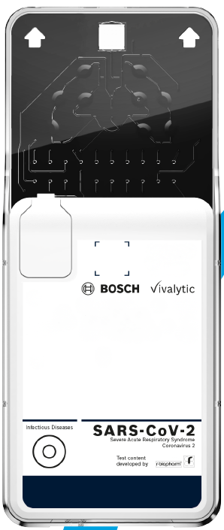
Accurate SARS-CoV-2 Testing in only 39 minutes!
A new breakthrough fully automated POC test for SARS-Cov-2 with results available in only 39 minutes.
Highly accurate with specificity at 95%

Slide 3
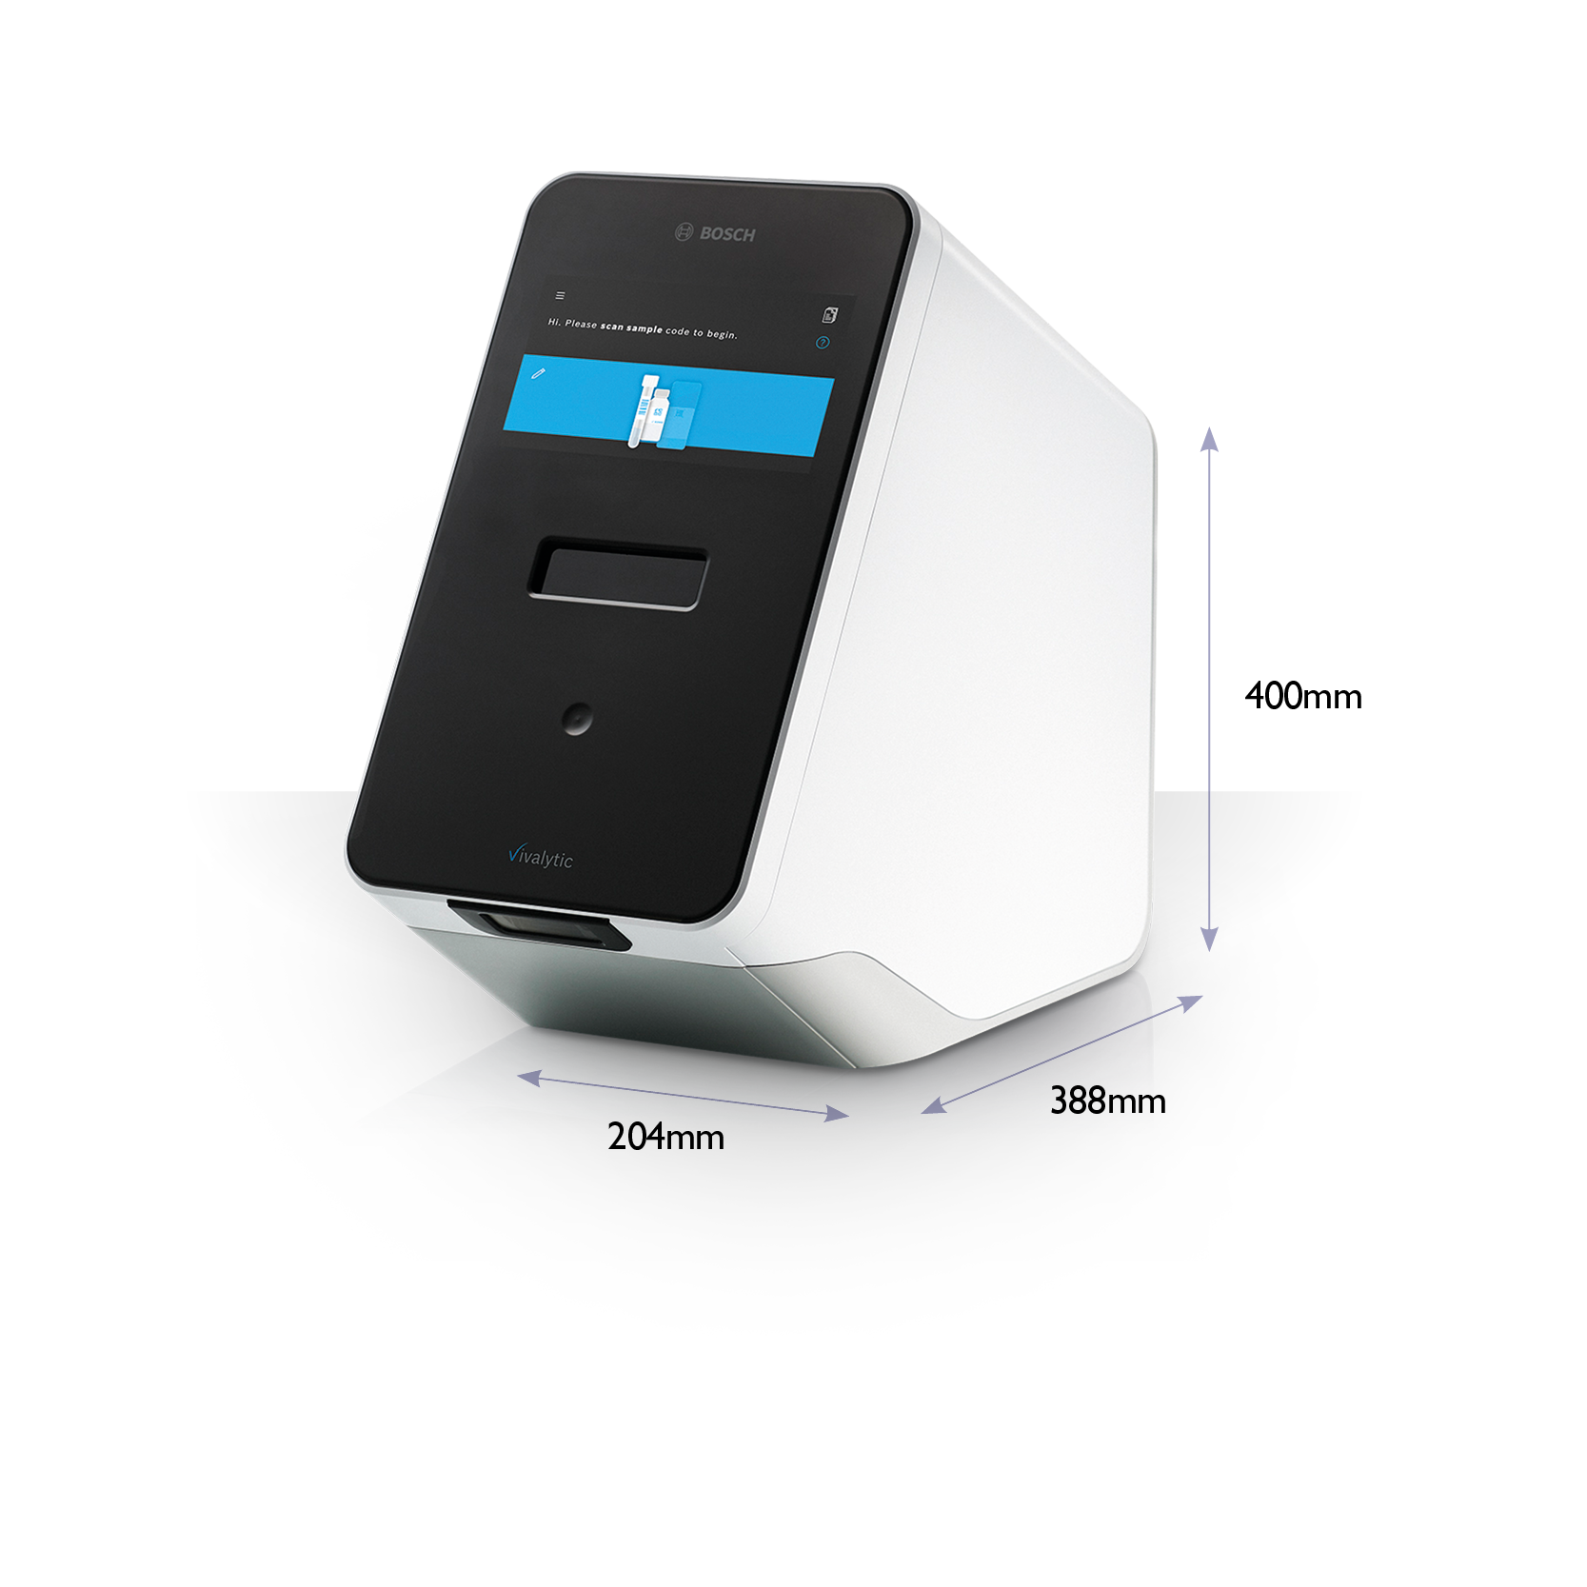
Vivalytic
One Device, Many Benefits
Fully Automated Molecular Platform
Vivalytic is capable of nucleic acid extraction, PCR, amplification and detection
Reduces the workflow of 4 laboratory rooms into one platform
Standalone Platform
No peripherals such as a laptop, keyboard or barcode scanner are required
No Laboratory Training Required
Vivalytic is a simple, easy to use platform which requires four simple user steps
Scan sample code
Scan cartridge code
Input sample into cartridge & close cover
Insert cartridge into Vivalytic

Slide 4
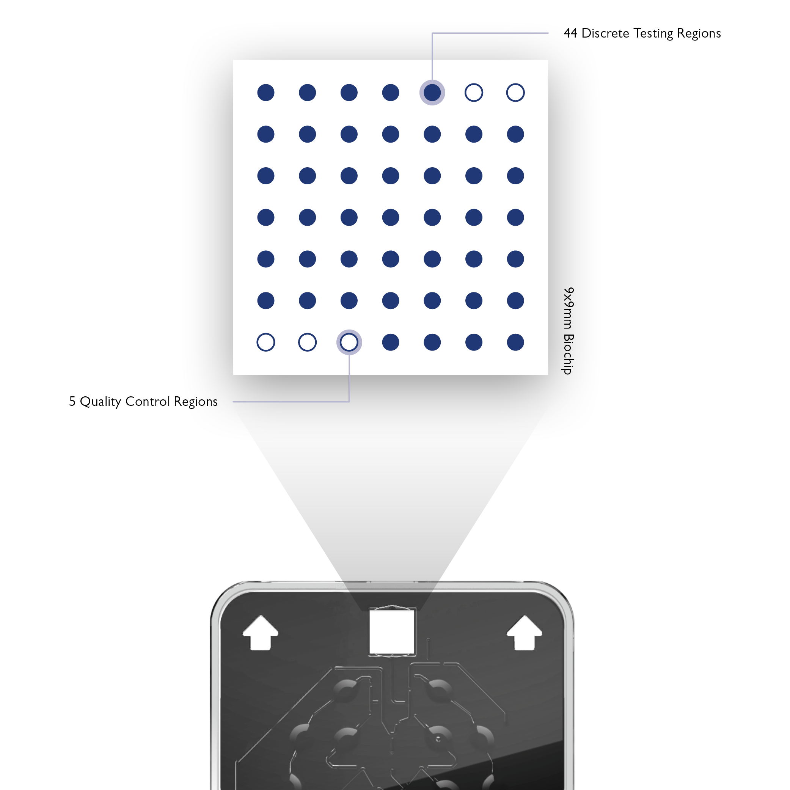
Vivalytic
Powered by Randox Biochip Technology
Biochip Array Technology allows simultaneous detection of multiple analytes from a single sample.
Main Features
A chemically activated 9x9mm ceramic chip
Currently 49 discrete test regions (includes 3 internal control/reference spots)
Offers more flexible batch sizes than traditional ELISA plate testing due to multiplexing.

Slide 5
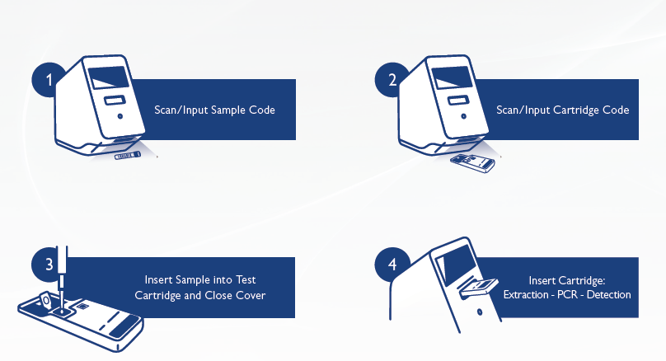
Vivalytic Worfklow

Slide 6
SARS-CoV-2 Test Options
Sample Type: Nasopharyngeal Swab
Sample Volume: 300μl Clinical Sample
Result Time: 39 minutes (Rapid Test)
2.5 Hours (1st generation Sars-Cov-2 test and extended VRI array)
SARS-CoV-2 Rapid Test
SARS-CoV-2 (COVID-19)
(1st Gen) SARS-CoV-2 Test
SARS-CoV-2 (COVID-19) & Sarbecovirus (SARS, SARS like, SARS-CoV-2)
(Extended) Respiratory Viral Infection Array
SARS-CoV-2 (COVID-19) | Adenovovirus A/B/C/D/E
Sarbecovirus (SARS, SARS like, SARS-CoV-2) | Enterovirus A/B/C
Coronavirus 229E/NL63 | Influenza A
Coronavirus OC43/HKUI | Influenza B
Middle East Respiratory Syndrome Coronavirus (MERS-CoV) | Rhinovirus A/B

Slide 7
Vivalytic
Fully Automated Molecular Workflow
Vivalytic condenses the work of four laboratory rooms into one point of care platform
Vivalytic reduces the time to result significantly to as low as 39 minutes
Vivalytic is a standalone platform that requires no laboratory training

Slide 8
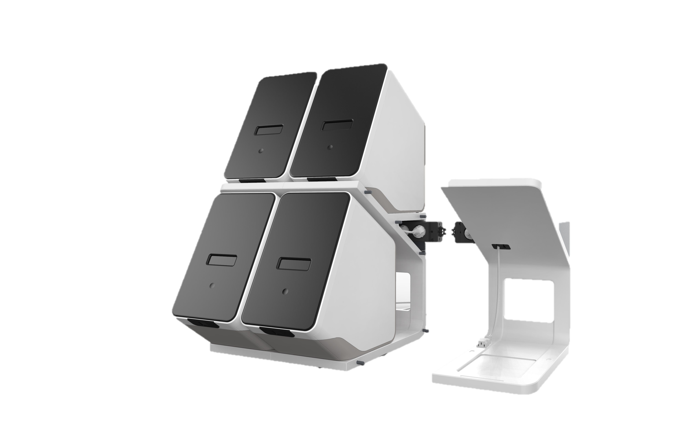
Vivalytic Up
Vivalytic is a versatile analyser suitable as a stand-alone platform. Alternatively, it can be transformed into a modular and
expandable system. Stacking of the analysers provides the user with a scalable, flexible and space saving
Molecular Diagnostic testing solution.
Vivalytic Up offers a multi-slot, random access testing platform allowing the user the ability to use one analyser as the master user-interface that communicates with the other analysers.
Integrated cable management is available allowing just one main power cable to power up to 8 analysers at one time.

