Slide 1

Animal Health Business Plan Chinese Market

Slide 2
MISSION & VISION
GREEN MOUNTAIN AND CLEAR WATER IS BETTER THEN GOLD AND SILVER MOUNTAIN
To provide alternative, breakthrough,
disinfecting technologies to reduce
exposure to toxic chemicals and
development of antibiotic resistance
…and developing botanically derived disinfecting products
to meet our customers’ needs in solving
today’s toughest pathogenic problems
Technology Developed and Proven
Large Markets of $5bn Targeted
Commercial Partnerships
established and revenue growth
Commercial Expansion and
2nd generation technology

Slide 3
Agenda
Part 1: Corporate presentation
Part 2: Technology
Part 3: Business Units
  Crop
  Surface
  Animal Health

Slide 4
Corporate presentation

Slide 5
SUMMARY
Laboratory M2 (LM2) wishes to divest certain assets of the company, hereafter collectively called the Animal Health Business Unit (AHDU)
Company Background
Laboratory M2 (LM2) based in Quebec, Canada, develops and markets a botanically derived, breakthrough disinfecting technology. Its mission is: To provide alternative, breakthrough, disinfecting technologies to reduce exposure to toxic chemicals and development of antibiotic resistance to meet our customers’ needs in solving today’s toughest biosecurity and pathogenic problems
Company is revenue generating, largely de-risked, and now in the excecutional phase of growth, with commercial success through key distribution contracts: Canada, United States, China, Japan, Eastern Europe (via Opus distribution partners), and Mexico . Products containing the LM2's proprietary formulations are trademarked as Thymox® and all provide highly effective, EPA registered, disinfecting and cleaning efficacy. LM2’s unique selling points are avoidance of a) exposure to toxic chemicals and b) development of antibiotic resistance. The patented, core formulation is based on thymol, which has natural antimicrobial properties. Use case have been developed for a variety pathogenic problems in Animal Health, Crop Science and Surface Disinfecting, specifically segmented into 4 markets and 3 business units.

Slide 6
COMPANY PROFILE
Laboratory M2, is a green technology, life sciences company, and maker of THYMOX®
Headquartered in Sherbrooke, Quebec
Focused on botanically derived disinfecting
Core formulation/technology can be applied to a variety of microbial pathogens problems
Commercial use cases in multiple markets
Sales and distribution on 3 continents, 5 countries
Company and technology is de-risked, over 5 years of in market experience
State-of-the-art laboratory and professional staff to support research and development
Strong intellectual properties strategy
Scale up of manufacturing completed, international footprint
Unlimited supply of raw materials and capacity of finished product
Fully in commercial expansion phase

Slide 7
ADVANTAGES AND CAPABILITIES
On trend technology
Growing markets
Large body of institutional knowledge
Base IP protected and registered
Innovative, commercialized products
In high growth commercialization phase
Scalable manufacturing capabilities, low CAPEX
Portfolio of strategic innovation in pipeline

Slide 8
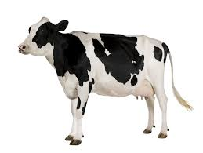
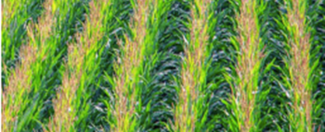

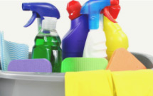
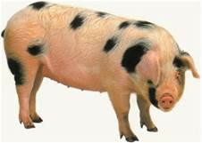
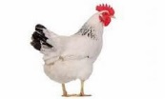
BUSINESS UNITS
Animal Health
Crop Protection
Surface Disinfecting
  Footbath solution for dairy cows (approved as veterinary drug in Canada)
  Topical wound dressing to combat hoof disease with broad applications in antibiotic stewardship; now seeking INADA approval to prosecute as an antibiotic alternative for lesions
  New formulations for pork and poultry viruses
  Various companion animal applications, including shampoos, antifungals and parasite repellents
  Antimicrobial, antifungal and insect repellent for crops/plants
  Next generation 25b product (which does not require EPA registration) for crop protection, to eventually include an organic product
  A line of general purpose disinfectant for building and remediation, branded Bioesque™, powered by Thymox®
  Consumer product, a ready-to-use spray for home use, Branded “Miracle Clean®”
  Wipes and laundry, dishwashing applications under development
  Bio-security applications for pork and poultry

Slide 9




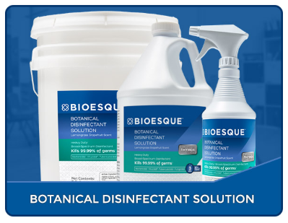
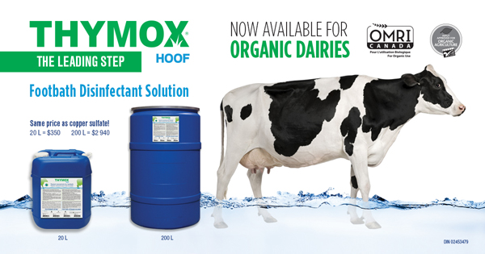
BRANDS PER BUSINESS UNITS
Surface Disinfecting
Animal Health
Crop Protection

Slide 10

ORGANIZATIONAL CHART
BOARD OF DIRECTORS
AUDIT COMITEE
COMPENSATION COMITEE
CEO
FRANK PALANTONI
FOUNDING PRESIDENT
SERGE AURAY
Chinese Advisor
BILLY HONG
FINANCING MANAGER
CATHERINE AUCLAIR
PRODUCTION AND SUPPLY MANAGER
GAÉTAN LEMIRE
V.P SALES MANAGER
ULYSSE D. DANDURAND
PRODUCT DEVELOPMENT & MARKETING MANAGER
GENEVIEVE LEGAULT
R&D MANAGER
ALIREZA ROOSTAEE
ACCOUNTING ASSISTANT
KARINE PELOQUIN
LABORATORY TECHNICIAN
FRANÇOIS LAVOIE
CHIEF PRODUCT
NICOLE ST-LAURENT

Slide 11
PATENT PORTFOLIO
Antimicrobial Nano-Emulsion (CROP 25b)
COMPOSITION FOR USE AS PESTICIDE, FERTILIZER, (CROP)
TOPICAL USE OF AN ANTIMICROBIAL FORMULATION (Dairy)
AQUEOUS DISINFECTANT FORMULATION (Surface)
Countries | PCT (Patent Cooperation Treaty) | United States | Canada | Australia | Japan | Mexico | Chile | Brazil | South Korea | Colombia | China | Hong Kong | European Union | Germany | France | Ubited-Kingdom | Netherlands | Ireland | Belgium | India | Philippines | Viet-Nam | Ivory Coast
Legend
Issued Patent
Pending Application

Slide 12
TRADEMARK PORTFOLIO
 | CANNAMOX
 | LABORATOIRE M2 & Drawing
 | THE HOMEGROWN INITIATIVE
 | THYMOX
 | THYMOX FOOTBATH
 | THYMOX GRO & Drawing
 | THYMOX HOOF
 | THYMOX HOOF DEFENDER
 | THYMOX HOOFCARE
 | THYMOX CONTROL & Drawing
 | THYMOX TECHNOLOGY
 | COUNTRIES | USA | CHINA | CANADA | EUROPE | INDIA | HONG KONG | JAPAN | VIETNAM
 | LEGEND
 |  | In Progress – For approbation
 |  | Registered

Slide 13
Technology

Slide 14
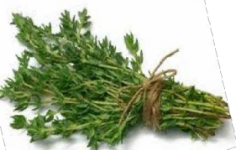
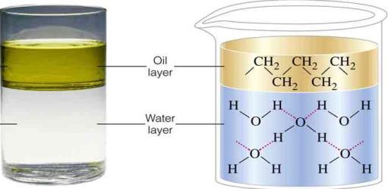
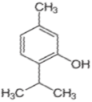
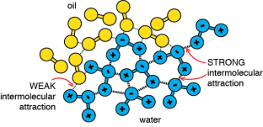
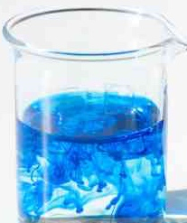
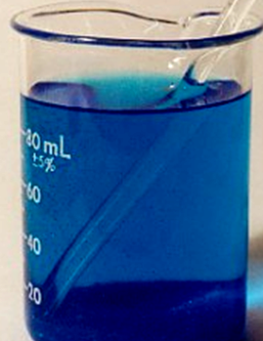
Unique Technology
Technology Overview
Thymol, the active, botanically derived antimicrobial, is well known, but difficult to use……it is not soluble in water (a phenol)
2 phases, majority of the activity is tightly bound, not available to disinfect
Thymol
Virtually 100% of the active is available
(nano -emulsion)
  THYMOX® technology solves the problem
Thymol
THYMOX® makes practical the antimicrobial power of nature

Slide 15
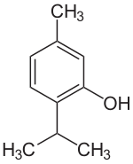
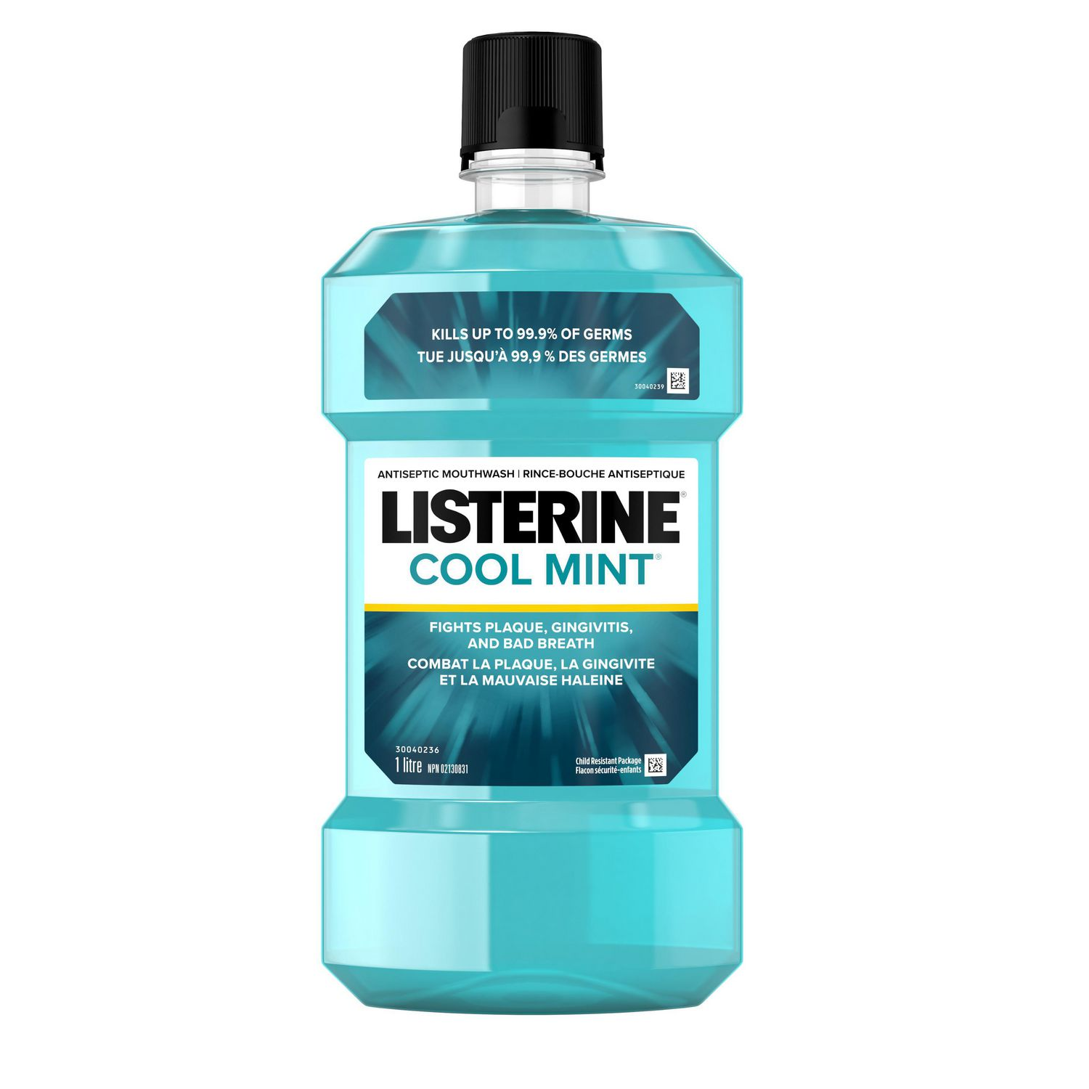
THYMOL OVERVIEW
SAFETY & EFFICACY
Long history of use (spice/preservative).
Unlikely that negative health effects will occur on long term.
Best efficacy amongst natural phenols
GRAS molecule (Generally Recognized As Safe)
Listed as a flavoring agent in the EU
EPA’s list of Minimal Risk Pesticides includes Thyme Oil
THYMOL

Slide 16
OUTSTANDING EFFICACY - KILLS 99.99% OF PATHOGENIC MICROBES
(EPA Registered RTU)
Product Profile
ANTIMICROBIAL EFFICACY
BACTERIA CONTACT TIME: 2 MIN | MOLDS/YEASTS CONTACT TIME: 3 MIN | VIRUSES CONTACT TIME: 1 MIN | SANITIZING CONTACT TIME: 30 SEC
S. aureus P. aeruginosa S. enterica L. monocytogenes E. coli / E. coli O157 :H7 S. suis VRE MRSA K. pneumoniae NDM-1 | T. mentagrophytes C. albicans | Influenza virus A HIV-1 Human Coronavirus | S. aureus E. aerogenes
 | MYCOBACTERIA CONTACT TIME: 3 MIN | NON-ENVELLOPED VIRUSES CONTACT TIME: 4 MIN
 | Mycobacterium bovis | Feline calicivirus (Norovirus surrogate)
Definition of 3 Levels of Disinfection
1.High-level disinfection -kills all organisms, except high levels of bacterial spores, and is effected with a chemical germicide cleared for marketing as a sterilant by FDA. Typically not used for generalized disinfecting.
2.Intermediate-level disinfection -kills mycobacterium, most viruses, and bacteria with a chemical germicide registered as a "tuberculocide" by EPA.
3.Low-level disinfection -kills some viruses and bacteria with a chemical germicide registered as a hospital disinfectant by the EPA.

Slide 17


Key advantages
Thymox is superior on all key attributes
Traditional Chemicals
Acids
Phenols
Aldehydes
Iodines
Oxide
Alcohol
Chlorine
Others
Environment
Botanically-derived, eco-friendly, biodegradable In less than 14 days
No field contamination so waste management is made easy
Does not harm aquatic life
People
Safe for Workers
Non-toxic Non-irritating
Equipment
Non-Corrosive, will not impact concrete or metal
Status
GRAS (Generally recognized as safe)

Slide 18
Key advantages
Disinfectant | Advantages | Disadvantages
Thymox | Botanically derived Biodegradable No field contamination Not corrosive Non toxic/Non irritating Safe to humans Kills bacteria/Fungi/All viruses | Efficiency against C. difficile and Aspergillus spores questionable
Chlorines | Biodegradable Low level of toxicity | Sporicidal properties questionable Skin irritation Corrosion of metals Manufacturing
Iodines | Biodegradable Effective against most vegetative bacteria | Gram negative bacteria can resist May stain skin and cause irritation Corrosive of some surfaces
Phenols | Broad spectrum antibacterial | Skin and mucous membrane irritant Toxic Not easily degradable Gram negative bacteria can resist
Aldehydes | Biodegradable | Extremely Pungent and suffocating odor Skin and mucous membrane irritant Can cause allergic dermatitis Potentially carcinogenic and corrosive

Slide 19

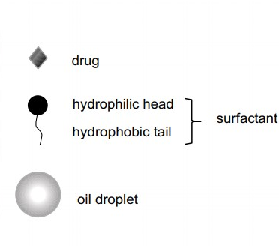

WHY ARE NANO EMULSION SUCH A UNIQUE TECHNOLOGY
A colloidal dispersion system that is thermodynamically stable
Consists of two immiscible liquids like water and oil (active ingredient)
Active Ingredient is a hydrophobic molecule with lipophilic characteristics, ex. phenols
It is stabilized by an interfacial film consisting of a suitable surfactant
Well below a micrometer in size
In water
Antibacterial active ingredient
Phenolic nano emulsions antimicrobial MOA is contact,
Therefore, smaller/more = less cost/more efficacy = more killing
THYMOX® is MORE EFFECTIVE for LESS the cost

Slide 20
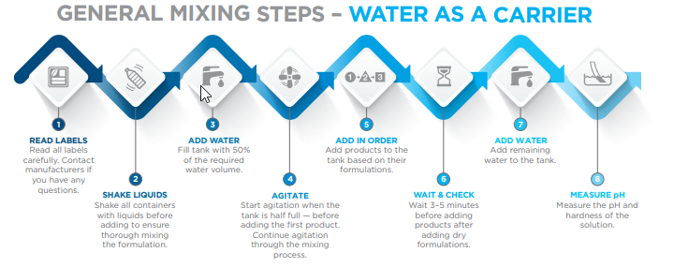
WHAT IS IMPORTANT AT FARM LEVEL
THYMOX technology can help farms to:
Minimize labor cost
  Ease preparation and mixing steps
  Avoid mixing errors
  No jar testing required
Save time during application
  No tank-mix agitation
  Same day tank-mix re-use
Substantial reduction of disinfectant cost
Higher efficacy against pathogenic microorganisms
Source: https://ppp.purdue.edu/wp-content/uploads/files/PPP-122.pdf
NO MIXING
STABLE CONSISTENT DELIVERY
THYMOX® is EASY TO USE

Slide 21
Business Unit
Crop Protection

Slide 22
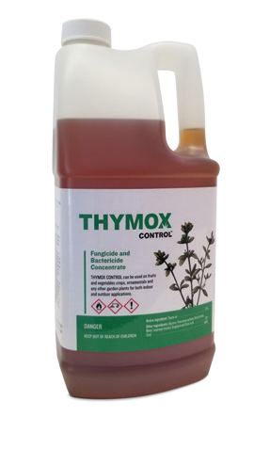



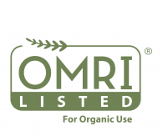
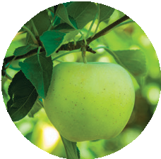
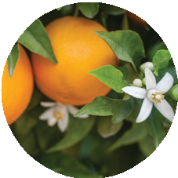
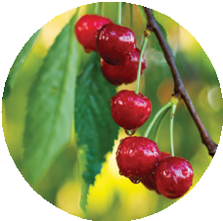
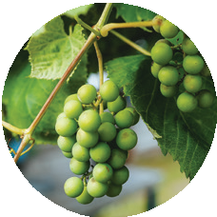
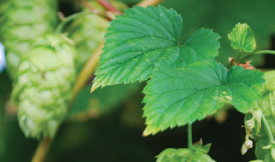
THYMOX CONTROL
THYMOX CONTROL® IS THE PERFECT SOLUTION
when synthetic pesticides and resistance-causing antibiotics are not appropriate.
INNOVATIVE
Built on 10 years of science and experience with botanically derived thymol-based products.
FIFRA 25(b)
THYMOX CONTROL® helps control fungal and bacterial diseases such as:
POWDERY MILDEW
GREY MOLD
(Botrytis cinerea)
FIREBLIGHT
(Erwinia amylovora)
ORCHARDS & VINEYARDS
OTHER VEGETABLE FARMING
NEXT STEP: Certification for Organic use
USE FOR:
Botanical Fungicide and Bactericide formulated using Thyme Oil

Slide 23
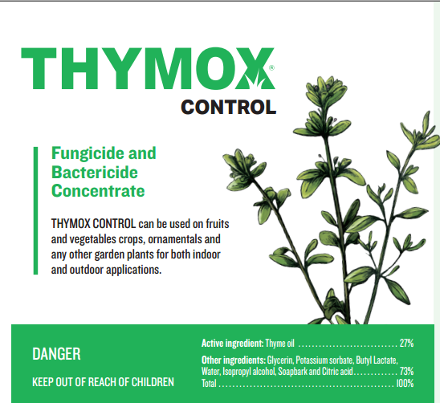
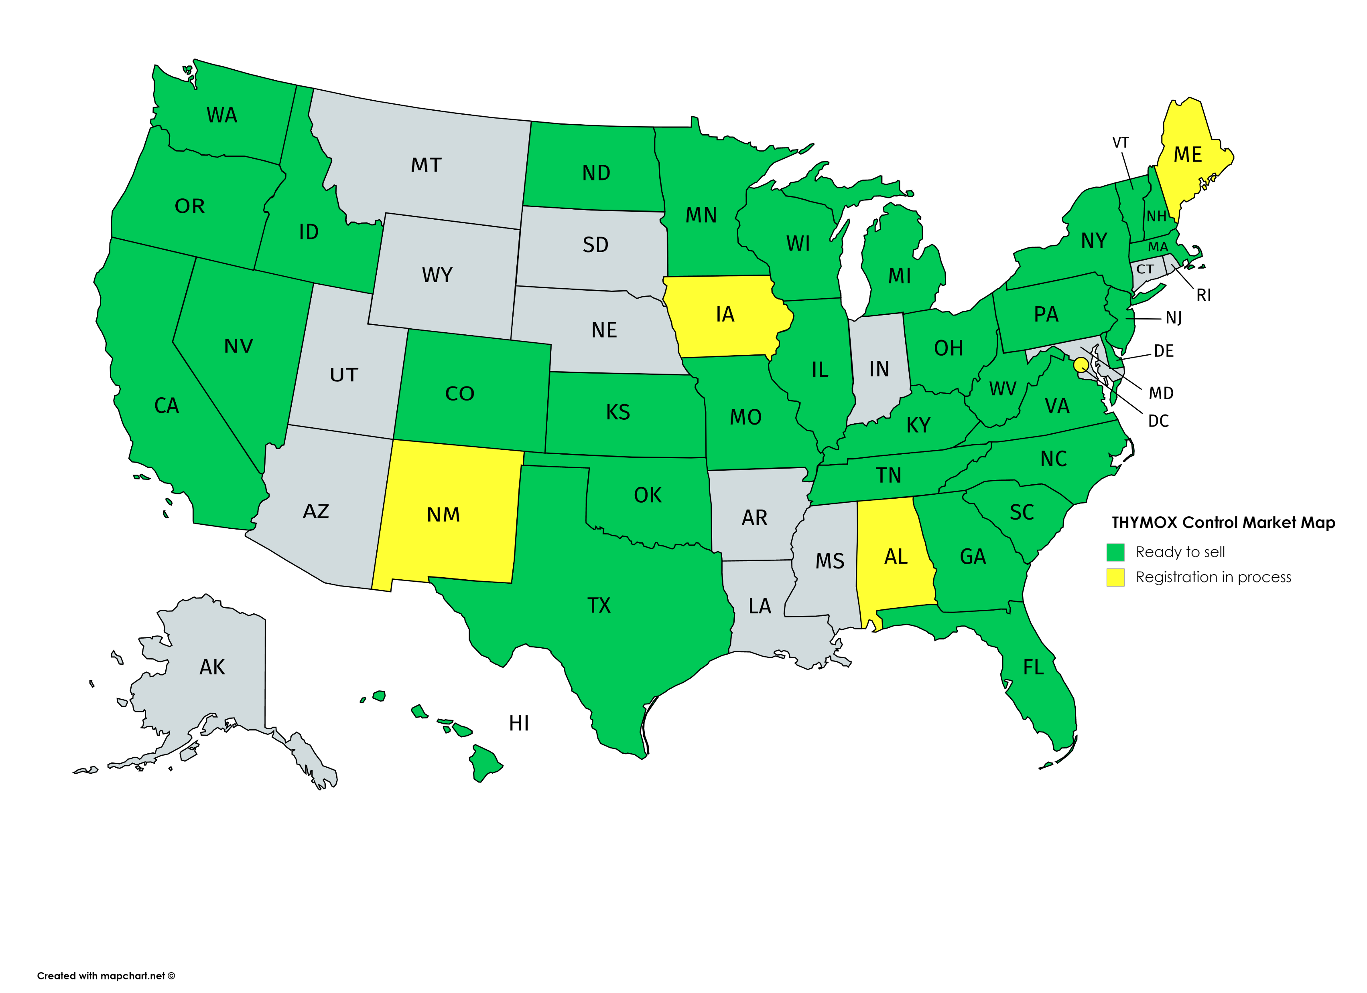
25 (b) Registration
32 States Registered
compliant for sale

Slide 24
Business Unit
Surface

Slide 25
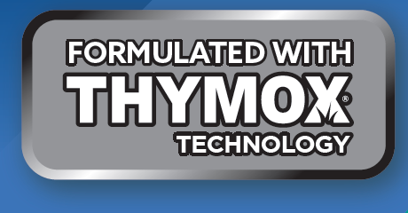
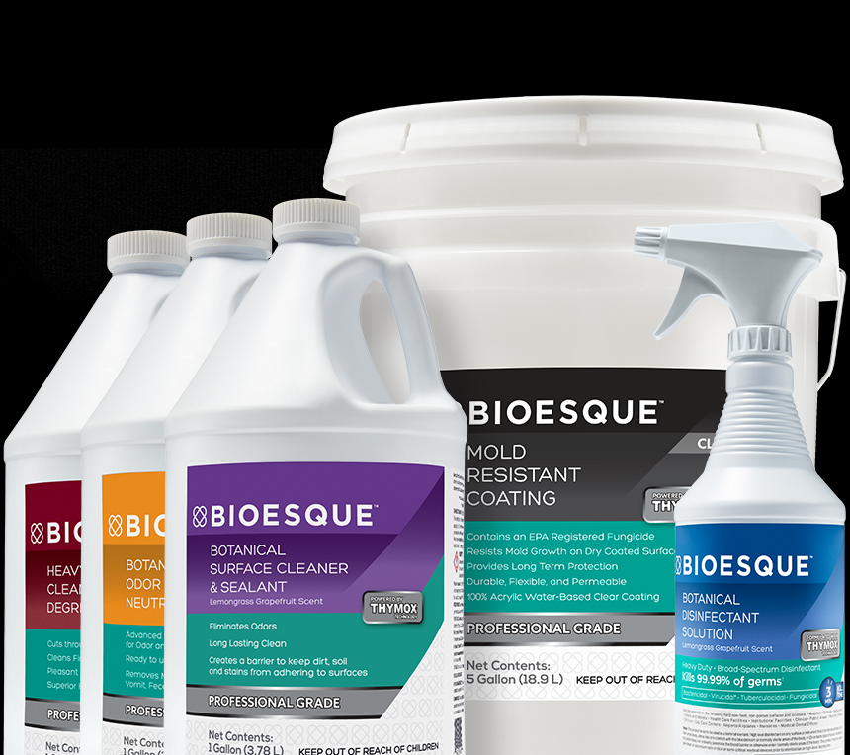
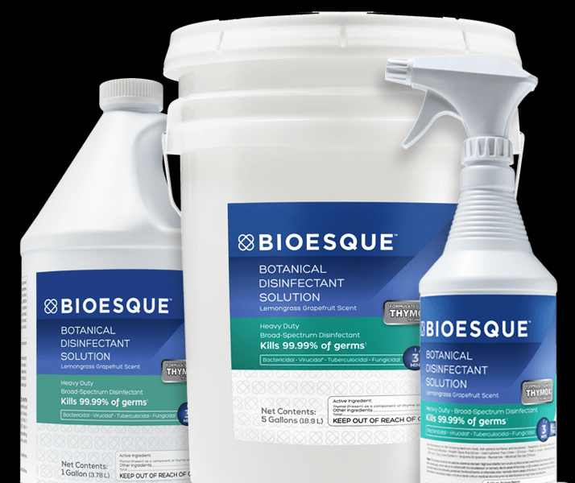
THYMOX DISINFECTANT
PROFESSIONAL GRADE
BOTANICAL DISINFECTANT & CLEANING SOLUTIONS
Bactericidal, Virucidal*, Tuberculocidal, and Fungicidal**
Disinfect, Sanitize, Clean, and Deodorize in ONE STEP

Slide 26
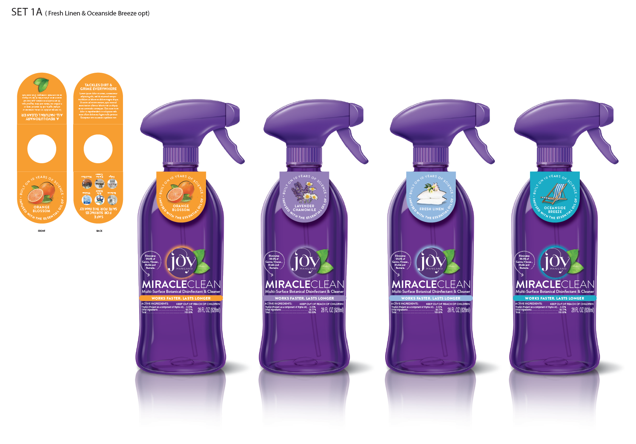
Retail
Thymox is commercialized in the retail channel
Approved Claims – EPA-registered label
Kills 99.9% of microbes as it cleans in 3 minutes, kills bacteria in 2 minutes!
A one-step disinfectant-cleaner
Botanically derived active ingredient
An essential oil technology
Contains no bleach, no phosphate
A non abrasive formula
Thyme for change… Cuts Cleaning Thyme!
No signal word or précautionner statement needed on the label !
Safe for surfaces - Non corrosive on surfaces - Will not scratch surfaces
An EPA-registered product, with proven efficacy!

Slide 27
Business Unit
Animal health

Slide 28
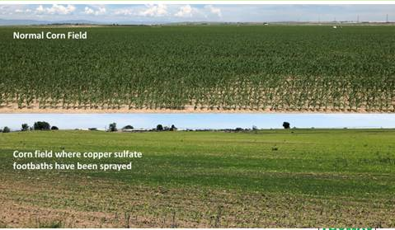
Dairy segment: A Changing Environment
Worldwide, a consolidation of dairy farms is happening.
Depreciated farm-gate prices for milk have now been the norm in the West for several years, putting more pressure on farms to be as efficient as possible.
Farms that are larger, progressive and pro-active in the fields of cow comfort, genetics nutrition and lameness generally fare better. These farms pay close attention to lameness and establish programs to address it, including footbaths.
Crop land productivity is essential to farmers, yet the most widely used footbath chemical, copper sulfate, will lead to devastating effects on yields.
Antibiotics use on farms is getting more scrutinized every year, which limits treatment options.
As a result: both prevention and treatment of lameness are facing significant challenges.

Slide 29



Dairy segment: our offer
The Thymox line of hoof care options bridges the gap between the farmers’ needs for:
Effective lameness prevention and treatment
Products that are safe for users, animals and environment
Convenience
products are:
Backed by a significant amount of science-based, comparative studies demonstrating their efficacy
Price-competitive vs copper sulfate
Easy and safe to handle liquids
Biodegradable
Non-antibiotics chemistries

Slide 30

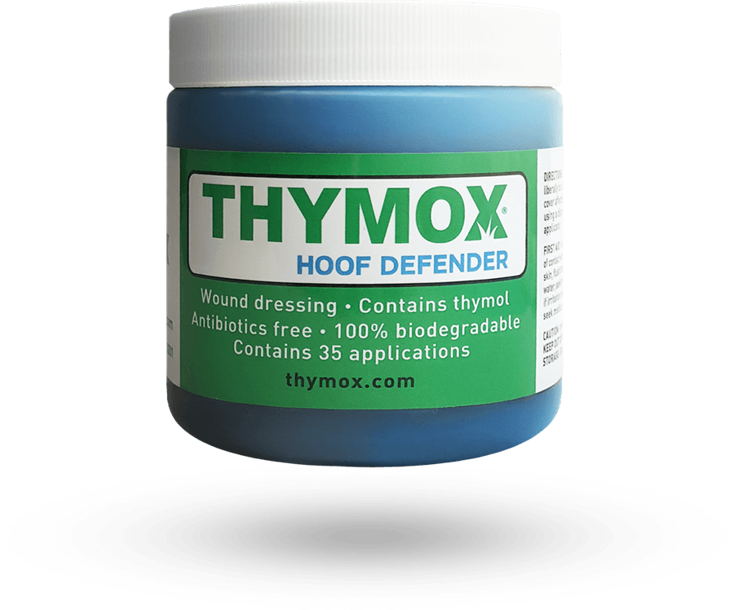
Dairy segment-product
Thymox Hoof Defender is a wound dressing topical gel made to be used on Digital Dermatitis lesions. It can be applied instead of antibiotics.
      Accelerates healing process associated with Digital Dermatitis lesions
      MoA is likely non-resistance inducing
      May offer an alternative
      to current antibiotic
      Pilot study results demonstrate healing acceleration

Slide 31

Dairy segment- Product
Thymox Footbath is a footbath product, for use in the control of Digital Dermatitis. It is similar to Thymox HOOF in composition and scope.
Easy to Use and Cost Effective
Concentrated solution in 20L – 200L – 1000L
Reliable hoof bath solution in a digital dermatitis control program (assessed by 3rd parties in several field trials)
Alternative to Copper Sulfate and Formaldehyde

Slide 32
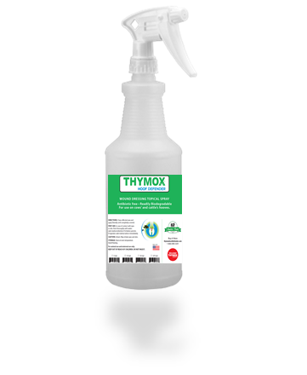
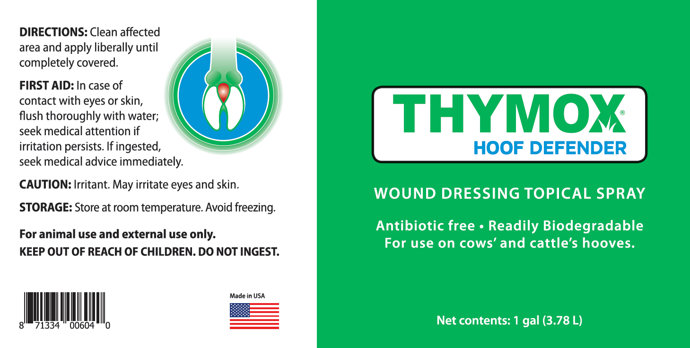
Dairy segment-Product
Thymox Hoof Defender is a wound dressing topical spray made to be used on Digital Dermatitis lesions. It can be applied instead of antibiotics. Suitable and convenient for milking parlor use.

Slide 33
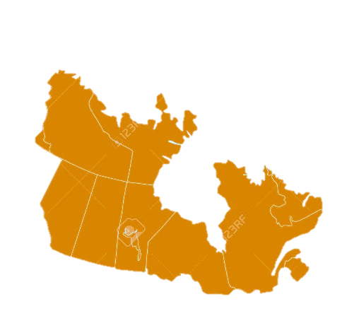


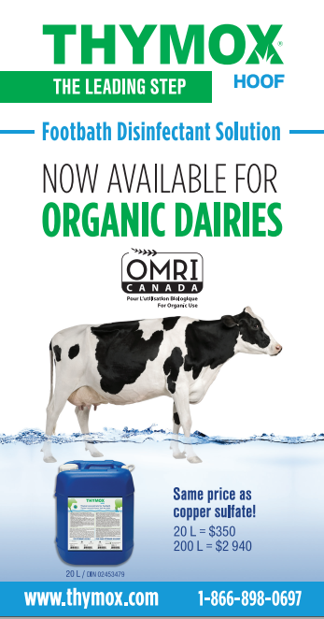
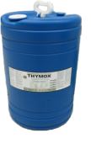
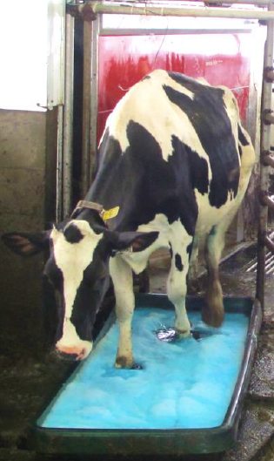

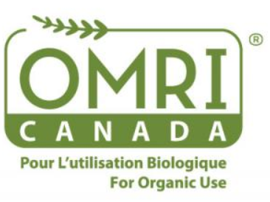
Dairy segment - Canada
CDMV showed its strength: easy access for vets with “one stop shopping”
Expanding sales by more aggressive, end user promotions
Canada
THYMOX Hoof :First and only footbath “drug” by Veterinary Drug Directorate (VDD), Health Canada
THYMOX Hoof Certified by OMRI and Québec Vrai for organic production.

Slide 34
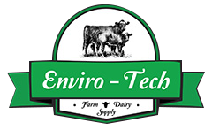

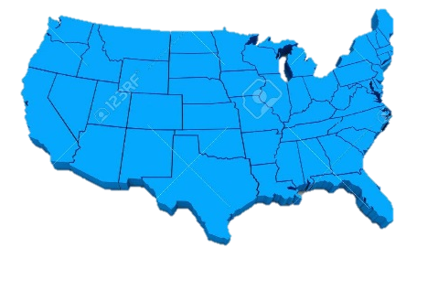


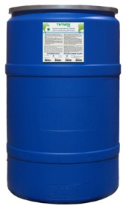
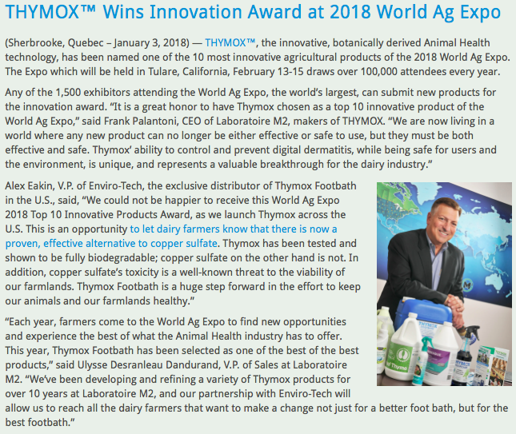
Dairy segment- USA
Converted 26 dairies with 130,000 cows
Opened 16 new dairies with 24,000 cows
USA
“We’ve been in the dairy footbath business for over 30 years, so we've seen firsthand the spread of digital dermatitis, and know that the current footbath methods are not sustainable. With THYMOX we are giving farmers a new, effective way to combat digital dermatitis without mortgaging the health and productivity of their fields or their health.”
John Eakin,
Founder and President

Slide 35

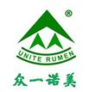


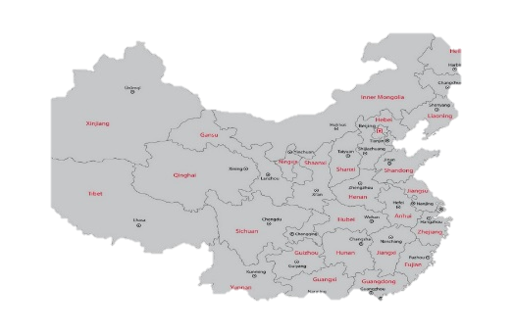
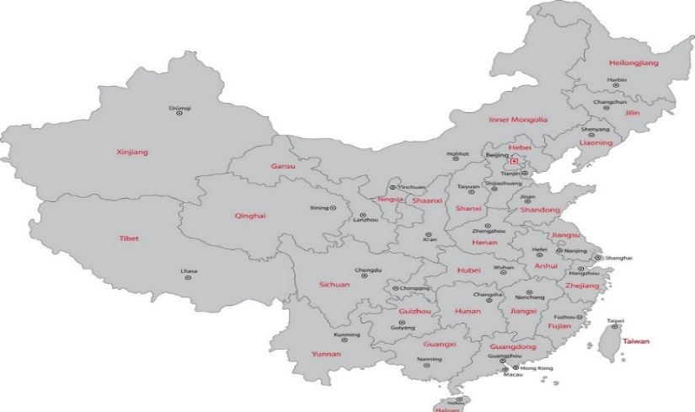
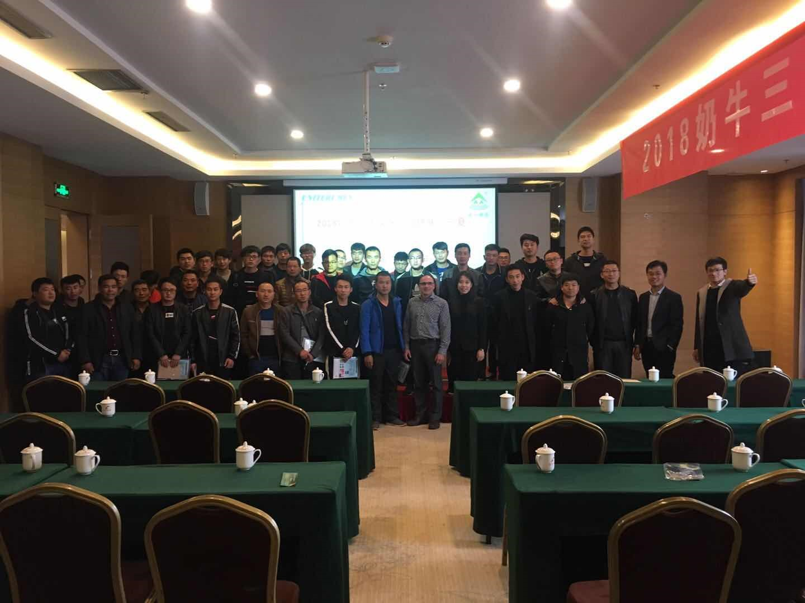
Dairy segment – China
  Accepted at 85 dairies
  Represents
  237,000 cows
  Very active in
  local marketing
Jixi
Heilongjiang Agricultural
Yinchuan
Ningxia Agricultural
Wenshang
Modern Farm
Hefei, Yili Farm Chenliu
Zhengzhou
Ruiya Farm Henan
China
Each year, Dr. Clavet spent 20 days in China on scientific lectures and hoof training

Slide 36

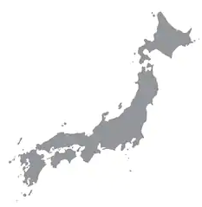
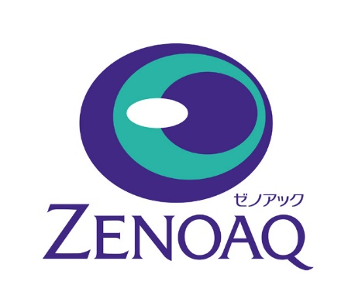
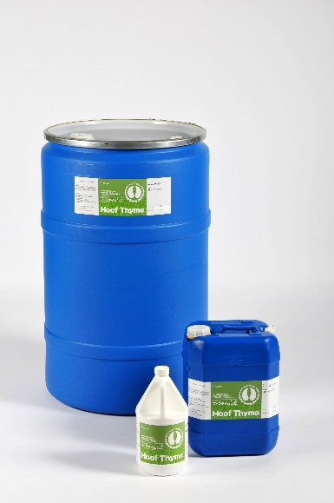
Dairy segment– Japan
We have been partners with Zenoaq in Japan since 2015.
They sell Thymox Footbath under the “Hoof-Thyme” brand
Their sales in the field have been steady over the years.
They are now adopting Thymox Hoof Defender as well.

Slide 37


Swine-poultry segment
THYMOX AG® Broad Spectrum (Virucidal* Bactericidal, Fungicidal, Tuberculocidal Disinfectant) Hard Surface Disinfectant concentrate for barns, animal husbandry, farms buildings and equipment.
Cleaning your barn without having to worry about your health, your employees’ health AND your animals’ health.
Non-corrosive: saves replacing heaters, door locks & other metal parts within barn that aren’t high grade stainless steel
Fully biodegradable in less than 2 weeks and certified UL EcoLogo

Slide 38



biosecurity
We provide a complete protocol to support our products.
LM2 has provided biosecurity guides for the disinfection of swine trucks, barns and equipment for all the swine industry in Canada.

