Slide 1
BIOMEME, INC. PRESENTS
Preventing the Spread of
COVID-19 On & Off
Cruise Ships
SARS-CoV-2 (COVID-19) Testing Options for the Cruise Industry
February 10, 2020

Slide 2
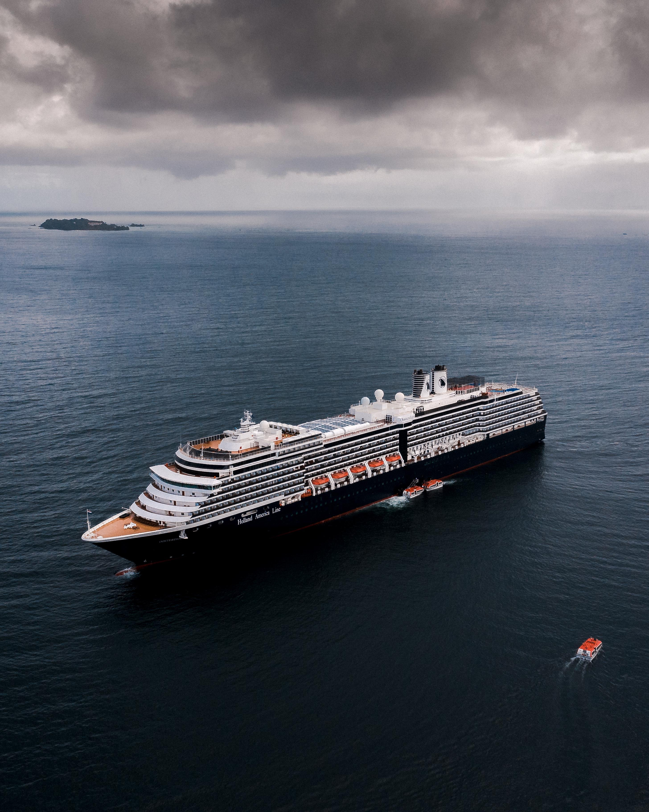
Contents
1
Companies Overview
About Biomeme and it’s subsidiary CLIA laboratory, One Health Labs
2
Biomeme’s SARS-CoV-2 Test
Overview of our shelf-stable, pre-mixed, and pre-aliquoted SARS-CoV-2 test + variant detection
3
3 Testing Options Explained
How Biomeme’s test can be administered anywhere (off-site, port of call, or onboard)
4
Additional Resources
Watch product demo videos, visit our help desk, or browse our online store

Slide 3
Biomeme
BIOTECHNOLOGY MANUFACTURER
Biomeme is about democratizing healthcare diagnostics. We create technologies to empower anyone, anywhere with the capabilities of a gold standard molecular lab in the palm of their hands regardless of experience.
Established 10/2012
250 full-time staff, across 4 states
8 global patent families (devices, software, plastics, tests)
Vertically Integrated (HW/SW/Biology R&D, HW & consumables manufacturing, diagnostic testing services)
100+ tests, including FDA and Health Canada EUA SARS-CoV-2 RT-PCR test
Shipping 50,000 SARS-CoV-2 tests per week (ramping to 100,000 per week in Q1 2021)

Slide 4
One Health Labs
CLIA LAB
A subsidiary of Biomeme, One Health Labs is our CLIA certified (No. 39D2172055) and CAP accredited (No. 8567607) lab specializing in rapid turnaround and mobile/on-site high-complexity diagnostic testing, including SARS-CoV-2.
Established 07/2019
Team of 150 and rapidly growing
7 labs across 4 states and growing
20,000 SARS-CoV-2 tests per week (and growing in less than 1 year)
Currently working with the largest Film, Television, and Commercial production studios (50+ and growing)
Received Emergency Use Authorization (EUA) from FDA for SARS-CoV-2 test on May 13, 2020

Slide 5
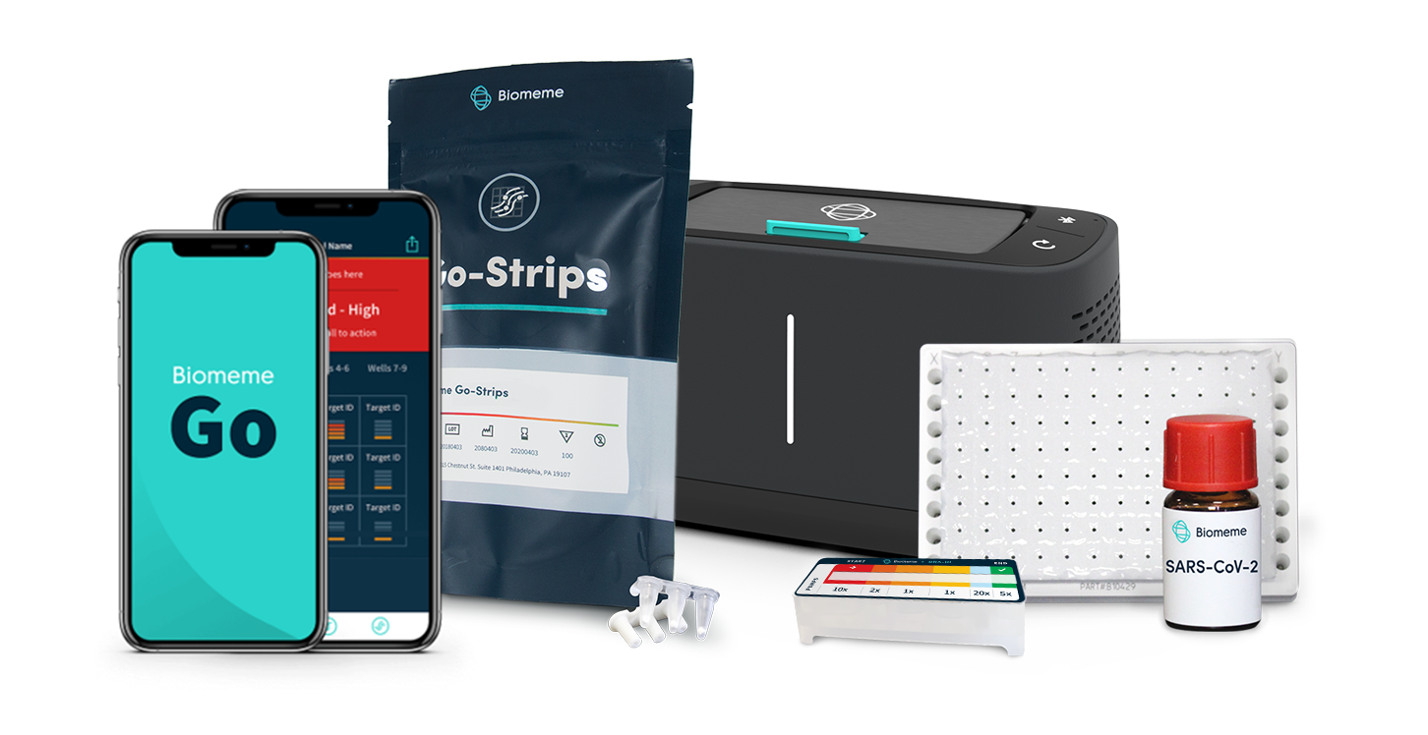
Biomeme’s SARS-CoV-2 PCR Test
FDA EUA
Biomeme’s SARS-CoV-2 test balances simplicity, mobility and throughput to ensure your customers and employees remain safe.
Molecular in-vitro diagnostic test available in multiple form factors for a variety of specimen types
Shelf-stable reagents (eliminates the need for cold-chain)
Detects 2 different SARS-CoV-2 genes (orf1ab and S) and is multiplexed together with our RNA Process Control (RPC) for monitoring RNA extraction and RT-PCR
Each reaction well already contains lyophilized master mix, enzymes, and multiplexed primer/probes for a triplex reaction
Highly sensitive with extremely low rate of false negatives and positives
1 portable Franklin™ thermocycler can test up to 9 samples simultaneously with results delivered to your smartphone in under 1 hour
Pictured here is Biomeme’s compact end-to-end platform including our portable Franklin™ thermocycler and its companion mobile app Biomeme Go, our SARS-CoV-2 Go-Strips optimized for field-use, our SARS-CoV-2 Go-Plates™ and Bulk Vials for high-throughput lab-use, and our M1 Sample Prep Cartridge Kits which require no heat block, vortexer, centrifuge, pipettes, or even electricity to use.

Slide 6
SARS-CoV-2 PCR Test Comparison
When evaluating different COVID-19 tests, it’s not only important to consider type of test (RT-PCR), sensitivity (97.46%), specificity (98.51%), limit of detection (1.8 genome equivalent per µL), time-to-result (55 min), FDA EUA (Yes) and variant detection (Yes), but also functional characteristics such as shelf-stability, portability, etc. especially as it applies to cruise ships. Below is a table of considerable advantages of the Biomeme SARS-CoV-2 test for cruise lines in comparison to other tests available on the market today.
Form Factor | Shelf Stable | Pre-Mixed | Pre-Aliquoted | Concentrated | RNA Process Control (RPC)
Go-Strips™
Go-Plates™
Bulk Vials
Most Other Assays

Slide 7
Detects New United Kingdom, South Africa, Brazil, and California Variants
Biomeme has confirmed, through in-silico analysis of the genetic sequences, that our SARS-CoV-2 test detects the new variants reported by the United Kingdom, South Africa, Brazil and most recently, California.
Variant | Country of Origin | Biomeme Assay Detection
20I/501Y.V1 | United Kingdom
20H/501Y.V2 | South Africa
20J/501Y.V3 | Brazil
GH/452R.V1/B.1.429/CAL20.C | California

Slide 8
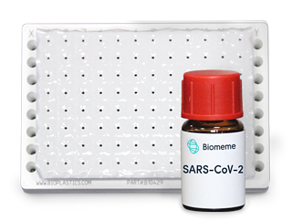
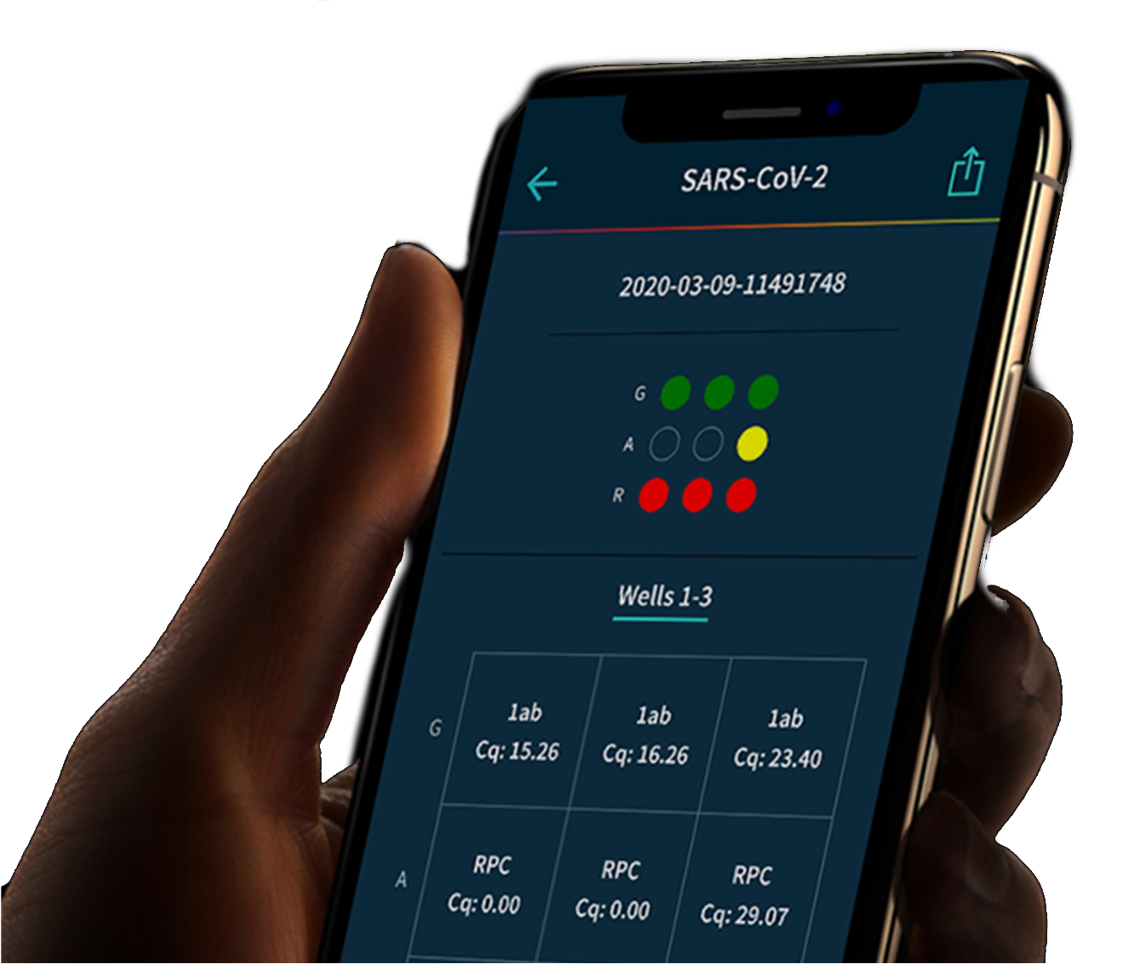
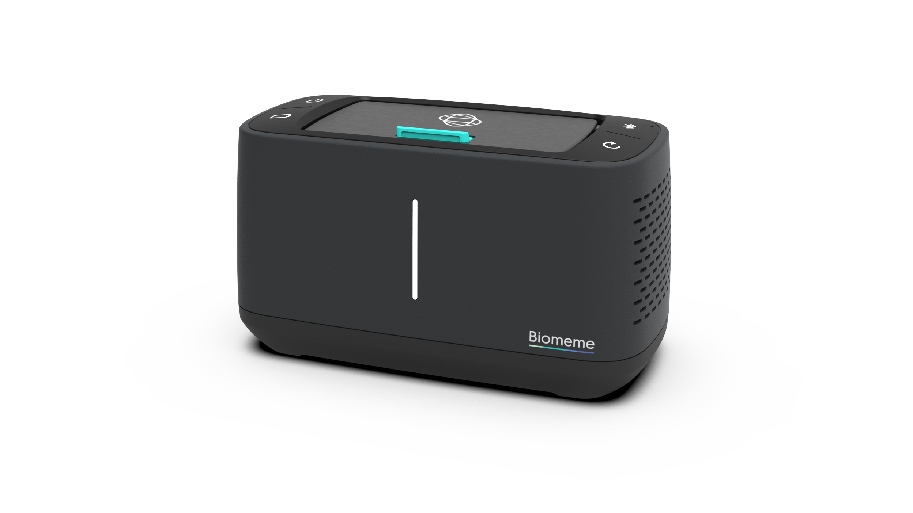
3 Testing Options For Cruise Lines
The flexibility of the Biomeme Platform allows us to provide COVID-19 testing regardless of patient location.
1
2
3
Primary Lab Site
Port of Call
Onboard
Off-site CLIA high-complexity laboratory
Samples are transported to the CLIA lab
Biomeme’s SARS-CoV-2 Go-Plates™ and Bulk Vials are used in conjunction with high-throughput lab equipment
Results within 24 hours
Temporary test site(s)
Samples are tested on-site using Biomeme Franklin™ thermocyclers and Go-Strips™
Samples can also be collected and couriered to the Primary Lab
Same day results
Fully mobile testing solution onboard the ship
No need for any additional lab equipment
Samples are tested on-site using Biomeme Franklin™ thermocyclers and Go-Strips™
Results within in 2-3 hours
Time to result may vary depending on number of lab technicians, thermocyclers, etc.

Slide 9
Additional Resources
Websites
Biomeme Franklin™
Learn more at info.biomeme.com/covid-19 and onehealthlabs.com
Learn more about setting up a mobile lab with our field-ready portable thermocycler
SARS-CoV-2 Video Showcase
Biomeme Help Desk
See Biomeme’s different SARS-CoV-2 form factors in use over at our Vimeo page
Learn more about Biomeme’s products by visiting help.biomeme.com
Biomeme M1 Sample Prep
Biomeme Online Shop
Learn more about our cartridge kits for extracting and purifying RNA in only a few minutes
Browse all Biomeme products for real-time PCR at shop.biomeme.com
For pricing or quote requests, please contact joe@biomeme.com. Thanks!

